Slide 1
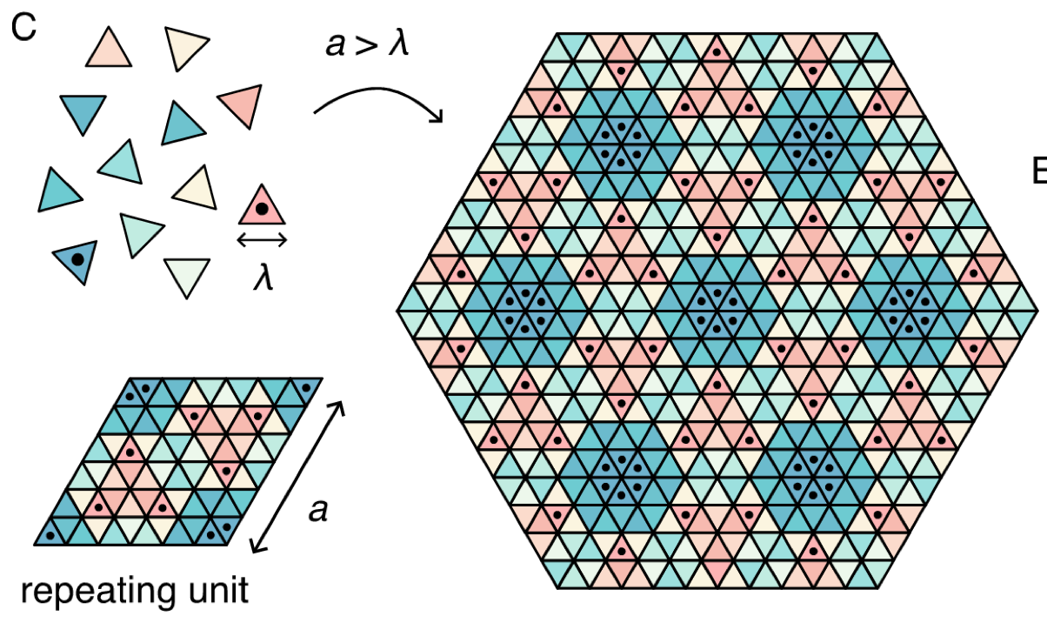
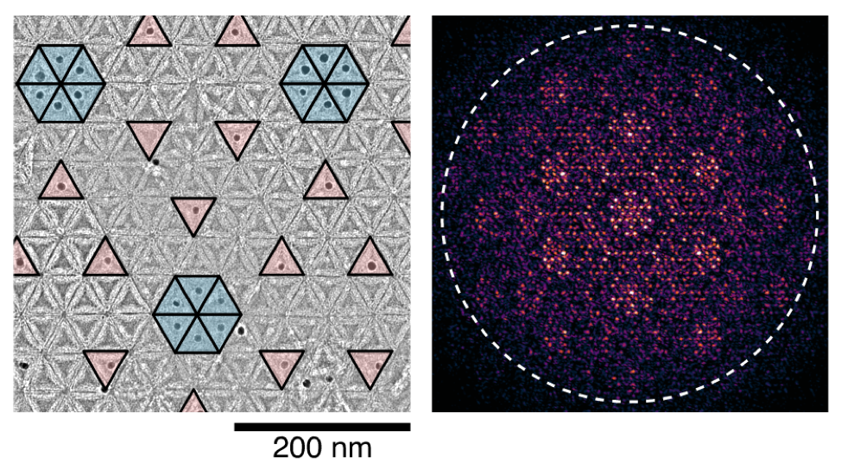
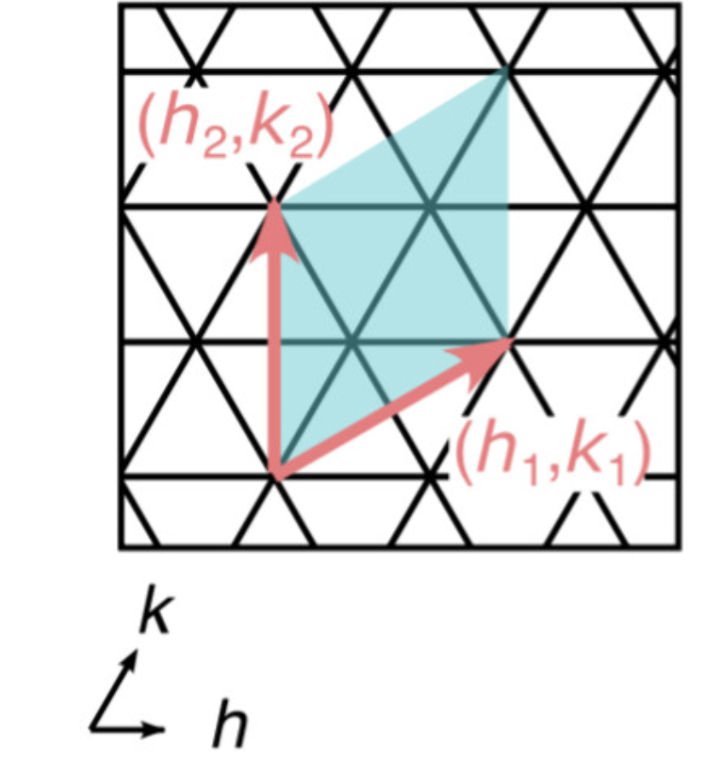
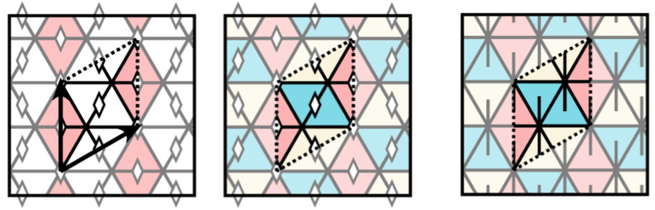

Brandeis University MRSEC
DMR-2011846
Symmetry-guided inverse design of self-assembling multiscale DNA origami tilings
D Hayakawa¹, TE Videbæk¹, GM Grason², WB Rogers¹
Triangular subunits with chemically specific interactions self-assemble into two-dimensional tilings with large unit cells comprised of many unique subunit species, which could find applications in photonics and plasmonics. New design algorithms show how to define the mutual interactions between the various particle species to produce a user-specified complex crystal with a multicomponent unit cell by exploiting symmetry. Experiments using DNA-origami subunits verify this design approach and produce two-dimensional tilings with unit-cell dimensions approaching the wavelength of visible light, as quantified by electron microscopy. An investigation of the design ecomomy, i.e., the number of unique subunits required to produce a tiling with a given unit-cell area, reveals a set of economical design rules to guide future experiments.
D Hayakawa, TE Videbæk, GM Grason, WB Rogers, “Symmetry-guided inverse design of self-assembling multiscale DNA origami tilings” ACS Nano (2024) 18 (29) 19169-19178.
¹ Brandeis University, ² U Mass Amherst
multiscale tiling
electron micrograph
Fourier
transform
  200 nm
16-color tubule
inverse-design process
pentamer
dimer
unit cell
symmetries
colors
orientations
Notes:
What Has Been Achieved: A combined experimental and mathematical study from PPs Rogers and Grason develops economical design approaches for creating multiscale, multicomponent two-dimensional crystalline materials by self-assembly. This study develops new design approaches for specifying the mutual interactions between many interacting subunit species such that they self-assemble into a user-specified two-dimensional tiling with high yield. By enumerating and assembling a wide variety of tilings with increasing unit-cell size and complexity, the authors identify economical design rules for targeting tilings with the largest unit-cell sizes using the minimum number of components.
Importance of the Achievement: The importance of this result is that it develops a systematic way to design and synthesize multiscale two-dimensional crystalline materials with large, complex unit cells via self-assembly. Because they can arrange metal semiconductor nanoparticles in two-dimensional arrays with a variety of user-programmed spacings, including spacings as large as the wavelength of visible light, these materials could find applications in photonics and plasmonics.
How is the achievement related to the IRG, and how does it help it achieve its goals? One of the two thrusts of IRG1 focuses on economical routes to self-limitation in equilibrium, self-assembled materials. This result helps to achieve the goals of IRG1 by elucidating how symmetry can be exploited to self-assemble crystalline materials with the largest, multicomponent unit cell using the minimum number of distinct components. Furthermore, this design algorithm can also be used to design periodic tilings for other self-limiting architectures, like cylindrical tubules and icosahedral shells.
Where the findings are published:
D Hayakawa, TE Videbæk, GM Grason, WB Rogers, “Symmetry-guided inverse design of self-assembling multiscale DNA origami tilings” ACS Nano (2024) 18 (29) 19169-19178; https://doi.org/10.1021/acsnano.4c04515

