Slide 1
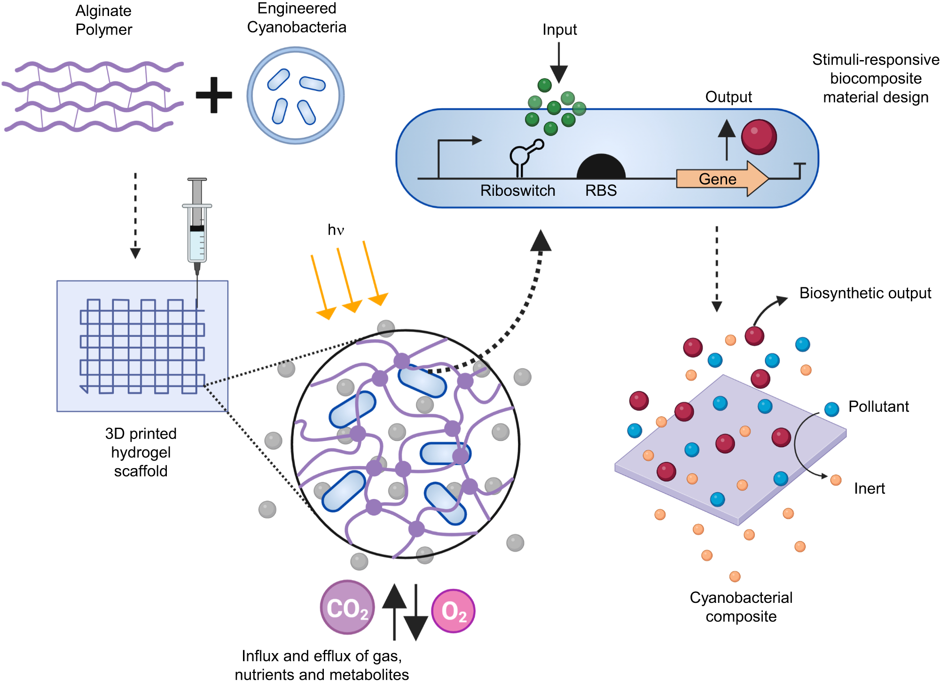
UC San Diego MRSEC
DMR-2011921
Cyanobacterial Composites Remediate Organic Pollutants
Jon Pokorski, Susan Golden, James Golden, Shaochen Chen, UC San Diego
What Has Been Achieved: Cyanobacterial composite materials were developed and programmed to remediate an organic dye pollutant and at the end of the materials life cycle were engineered to undergo cell death
Importance of the Achievement: Industrial pollutants are ubiquitously found in fresh water sources. This work demonstrated how a harmless photosynthetic organism could be programmed to remediate textile dye pollutants, which could be extended to many other sources of industrial pollution.
Relation to the IRG2: A primary goal of IRG2 is developing composite materials that can respond to their environment. In this case, the team engineered a riboswitch into the material that allows genes to be activated in the presence of a small molecules present in tea.
Nature Communications, 2023, 14, 4742; https://doi.org/10.1038/s41467-023-40265-2
Notes:
What Has Been Achieved: Genetically engineered cyanobacteria have been 3D printed in an alginate matrix. The polymer supports sustained growth and health of the cells. A variety of features were programmed into the cell, namely the control of genes using a riboswitch. In the final incarnation, the cells were programmed to constitutively express a laccase gene, which served to decontaminate organic pollutants, and a cell lysis gene under control of a riboswitch. Thus, when the material finished its job, the cells could be killed by adding an inducer molecule.
Importance of the Achievement: Organic pollutants are ubiquitous near industrial sites and a bio-friendly solution to remediation would be a promising achievement. In this case, the team uses harmless microbial organisms to achieve waste-water decontamination and then program them to die in the case of any environmentally detrimental outcome.
How is the achievement related to the IRG, and how does it help it achieve its goals? A primary goal is to achieve composite materials that are stimuli responsive. This performs exactly that by combining expertise in materials science, chemical/biochemical characterization, and cyanobacterial genetics to accomplish the goals.
Where the findings are published: Nature Communications, 2023, 14, 4742, https://doi.org/10.1038/s41467-023-40265-2
.

