Slide 1
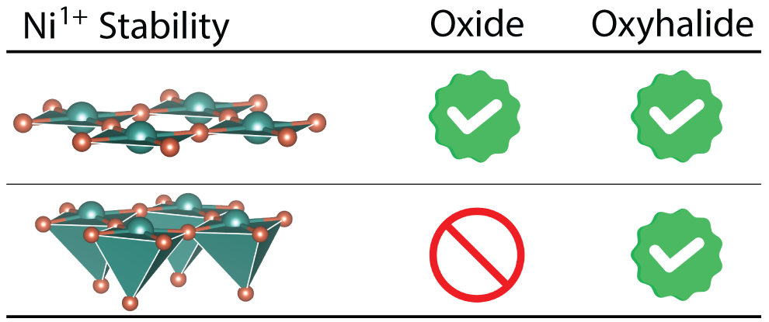
Northwestern MRSEC
DMR-1720139
Heteroanionic Stabilization of Ni¹⁺ with Nonplanar Coordination
IRG-2, Northwestern University MRSEC
Achievements
Electronic structure calculations predict two new layered nickelate oxyfluoride materials derived from the Ruddlesden-Popper structure.
The designed materials host Ni¹⁺ in 4-coordinate square planar and 5-coordinate square pyramidal geometries, the latter enabled by the heteroanionic ligands.
Predicted chemical reactions with high thermodynamic driving forces to guide the synthesis of these materials.
Significance. These new materials closely resemble undoped cuprate superconductors in their electronic structure. The approach of using heteroanionic materials (combining oxygen and fluorine) offers a new strategy for realizing cuprate-like physics in nickelates, which could lead to the discovery of new superconducting materials.
Relationship to IRG-2. The work establishes a promising new direction for the search of nickelate superconductors with potentially higher critical temperatures and offers heteroanionic synthesis strategies for experimental verification.
Physical Review Materials, 8, 024803 (2024).
Notes:
What Has Been Achieved: Heteroanionic Stabilization of Ni1+ with Nonplanar Coordination
Importance of the Achievement: The square-planar geometric requirement proposed by Anisimov in 1999, and pursued over the last three decades of nickelate research to stabilize Ni¹⁺, can be inherently circumvented in oxyfluorides.
How is the achievement related to the IRG, and how does it help it achieve its goals? The new coordination and oxidation state are enabled by the heteroanionic elements. Beyond reporting on the electronic properties of these novel compounds, multiple synthesis pathways are reported to obtain the targeted product with the non-square planar geometry.
Where the findings are published: Phys. Rev. Materials, 8, 024803 (2024). https://doi.org/10.1103/PhysRevMaterials.8.024803

