Slide 1
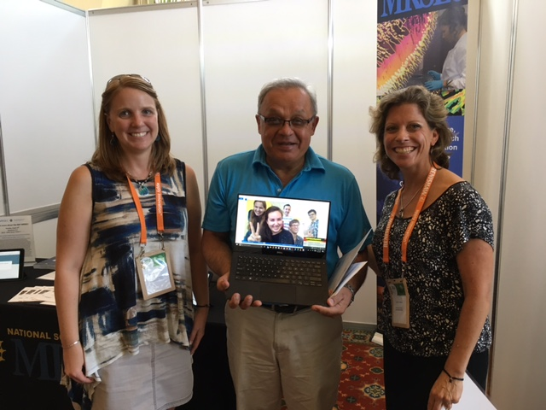
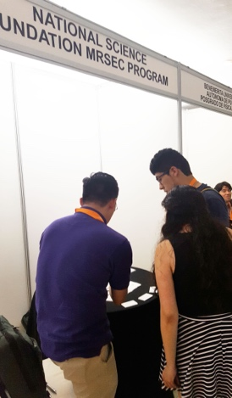
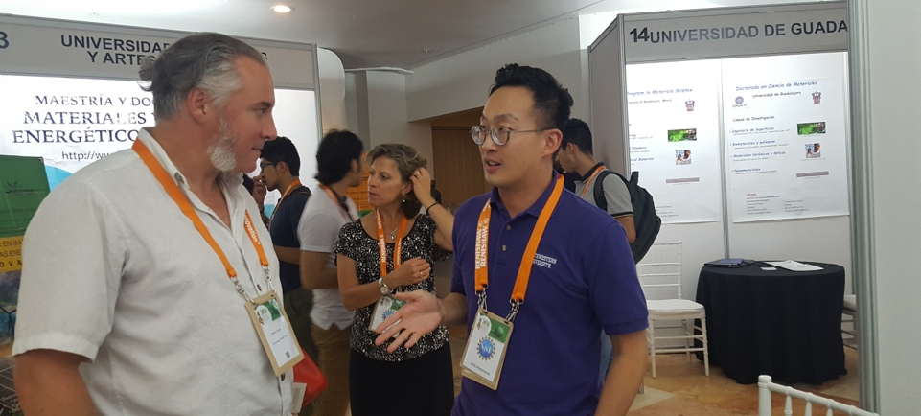
NSF-MRSEC Booth at the International Materials Research Congress
NSF-MRSEC DMR-1121262
International Outreach, Northwestern University MRSEC
Following a successful inaugural year in 2016, a NSF-MRSEC booth was again featured at the XXVI International Materials Research Congress (IMRC) in Cancun, Mexico on August 19-25, 2017 to increase awareness, promote international collaboration, and broaden participation from traditionally underrepresented groups in the National Science Foundation Materials Research Science and Engineering Center (NSF-MRSEC) program. Dr. William Kung (Northwestern University), Ms. Michelle McCombs (Ohio State University), and Ms. Kristen Dreyer (Pennsylvania State University) led the MRSEC booth and organized booth-related logistics across all 21 MRSECs. Annually, the IMRC is attended by approximately 1,800 attendees from more than 40 countries.
MRSEC representatives and conference attendees interact at the International Materials Research Congress in Cancun, Mexico.

