Slide 1
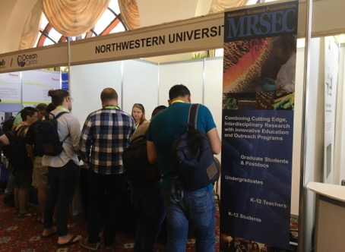
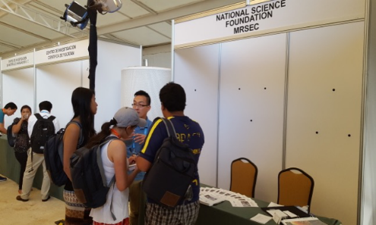
NSF-MRSEC Booth @ XXV International Materials Research Congress Cancun, Mexico
NSF-MRSEC DMR-1121262
Northwestern University
To increase awareness, promote international collaboration, and broaden participation from traditionally underrepresented groups in the National Science Foundation Materials Research Science and Engineering Center (NSF-MRSEC) program, an NSF-MRSEC booth was featured at the XXV International Materials Research Congress (IMRC) in Cancun, Mexico on August 14-19, 2016. In 2016, Dr. William Kung (NU-MRSEC, Director of Operations) and Dr. Michelle McCombs (Ohio State University MRSEC, Program Manager) led the MRSEC booth effort and organized booth-related logistics across all 21 MRSECs. In total, 117 IMRC attendees visited the NSF-MRSEC booth

