Slide 1
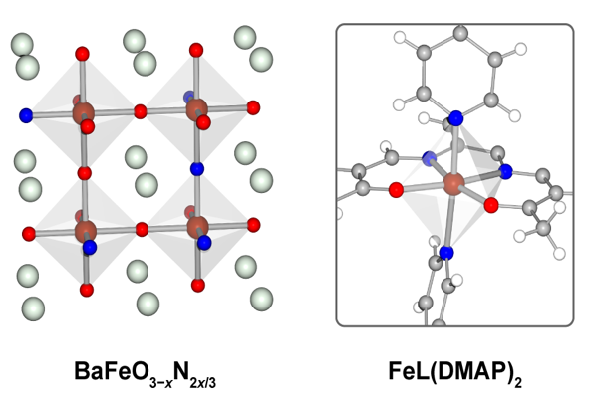
Harnessing Mixed Anion Materials for Novel Magnetic Properties
NSF DMR-1720139
2018
Seed Research, Northwestern University MRSEC
Precise synthetic control of the local electronic structure of metal centers within materials offers the potential to realize exotic physical properties. In particular, tuning the electronic structure of metal centers enables the creation of strongly correlated electron systems, enabling the exploration of fundamental questions about magnetism and superconductivity. In a new seed project within the Northwestern University MRSEC, novel classes of mixed anion materials are being synthesized in an effort to realize new correlated electron properties and related quantum phenomena. One particular example is spin crossover, which occurs when the repulsive electron pairing interaction is energetically balanced with the ligand field splitting. Therefore, tuning the ligand field splitting hold promise for the rational synthesis of solid-state spin crossover materials.
Mixed anion systems such as the oxynitride compound on the left provide a rational pathway toward solid-state spin crossover materials that are inspired by analogous molecular systems such as the example on the right.

