Slide 1
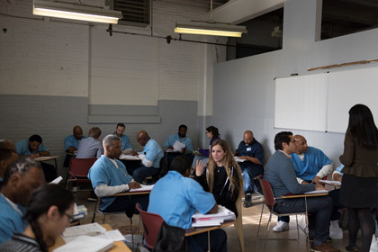
Northwestern Prison Education Program
NSF DMR-1720139
2020
Education/Outreach, Northwestern University MRSEC
The Northwestern Prison Education Program (NPEP) is an initiative to provide a high-quality liberal arts and STEM education to incarcerated students in Illinois in partnership with Oakton Community College and the Illinois Department of Corrections (IDOC). Responding to the crisis of mass incarceration, NPEP fills a vital need by being the only degree-granting program in the State of Illinois with a full liberal arts curriculum including STEM courses for incarcerated students. NPEP is also the only postsecondary prison education program in the State of Illinois that accepts applications from facilities throughout the state, including maximum-security prisons. In this manner, NPEP achieves statewide impact, ultimately increasing the likelihood of successful rehabilitation and reincorporation into society upon release. The Northwestern University MRSEC supports three NPEP courses including a STEM laboratory section at the Stateville Correctional Center.
The Northwestern Prison Education Program (NPEP) offers chemistry, mathematics, and biology courses at the Stateville Correctional Center, which is a maximum-security prison in Crest Hill, Illinois. By providing a full liberal arts and STEM postsecondary curriculum, NPEP increases the likelihood of successful rehabilitation and reincorporation into society upon release.

