Slide 1
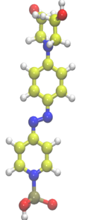
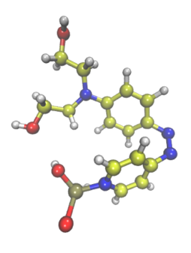
Optically Reconfigurable Dielectrics in Ultra-Thin Transistors
NSF DMR-1720139
2019
IRG-1, Northwestern University MRSEC
Charge transport in ultra-thin transistors strongly depends on the characteristics of the dielectric layer poised between the gate electrode and the current-conducting semiconductor channel. The current modulation scales with the capacitance, and therefore the inverse dielectric thickness, which is fixed in conventional devices. In this work, molecular self-assembly of highly polarizable PAE molecules was used to create reconfigurable dielectric layers whose capacitance changes with illumination. Upon ultraviolet optical illumination, the PAE molecules undergo a photoisomerization from an extended trans geometry to a compact cis geometry, which can be reversed upon illumination at longer wavelengths. The accompanying capacitance modulation provide new functions to optoelectronic devices. For example, the output of the photo-reconfigurable transistor depends on prior optical stimulation, combining the functionalities of logic and memory through the integration of new low-dimensional reconfigurable materials.
PAE
365 nm
λ > 400 nm
trans
cis
hν
Polymer
channel
PAE
dielectric
Transparent ITO/glass gate
Optical illumination penetrates an ultra-thin transistor to induce molecular reconfiguration of the thin PAE gate dielectric, thereby modulating the transistor output in a reversible manner.
ACS Applied Materials & Interfaces, 10, 21492 (2018).
Notes:
For more information, please see the following publication: S. P. Senanayak, V. K. Sangwan, J. J. McMorrow, K. Everaerts, Z. Chen, A. Facchetti, M. C. Hersam, T. J. Marks, and K. S. Narayan, “Self-assembled photochromic molecular dipoles for high-performance polymer thin-film transistors,” ACS Appl. Mater. Interfaces, 10, 21492 (2018).

