Slide 1
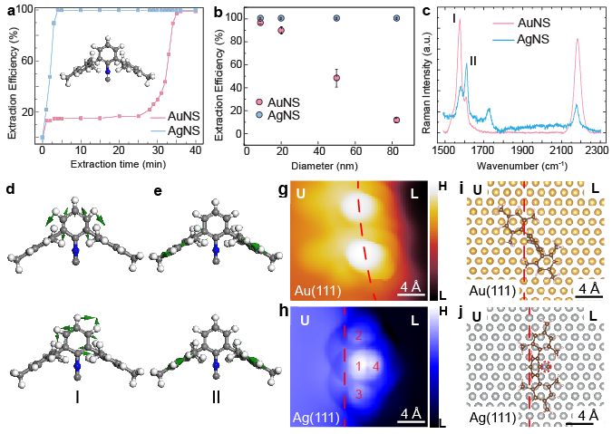
UC San Diego MRSEC
DMR-2011921
IRG1: Modification of Plasmonic Nanocrystals with Sterically-Encumbered Isocyanide Ligands
Joshua Figueroa, Tod Pascal, Shaowei Li, Andrea Tao: UC San Diego
What Has Been Achieved: Observation of ring breathing motions indicate that m-terphenyl isocyanide ligands (CNAr^{Mes2}) adopts strikingly different orientations on Au versus Ag surfaces: vertical adsorption geometry on Au and a planar adsorption geometry on Ag.
Importance of the Achievement: Surface ligands are critical in determining the chemical and physical properties of plasmonic nanoparticles. These results provide new insights into the molecule-surface interactions of m-terphenyl isocyanide ligands
How is the achievement related to the IRG, and how does it help it achieve its goals? These results will enable the synthesis of new synthesis of patchy or surface-patterned plasmonic nanoparticles that can serve as novel nanoscale building blocks for self-assembly, bridging the chemical spectrum between inorganic nanoparticles (non-specific binding) and proteins (specific binding).
Bi, et al. Nano Letters 2025 25 (5), 2027-2033. DOI: 10.1021/acs.nanolett.4c05885
https://doi.org/10.1021/acs.nanolett.4c05885
Notes:
What Has Been Achieved: IRG1 has uncovered the impact of molecular orientation on m-terphenyl isocyanide ligand (CNArMes2) binding to metal nanocrystals using surface-enhanced Raman spectroscopy (SERS), where molecular motions are amplified when aligned with the optical near-field. This is further confirmed by scanning tunneling microscopy and density functional theory (DFT) calculations of CNArMes2 bound to model Au(111) and Ag(111) surfaces. Observation of ring breathing motions indicate that CNAr^{Mes2} adopts strikingly different orientations on Au versus Ag: vertical adsorption geometry on Au and a planar adsorption geometry on Ag.
Importance of the Achievement: Surface ligands are critical in determining the chemical and physical properties of nanocrystals and nanoparticles. However, site-selectivity and preferential binding of these ligands are poorly understood. These results provide new insights into the molecule-surface interactions of m-terphenyl isocyanide ligands and how sterics interactions can be used to design chemoselectivity in ligand binding.
How is the achievement related to the IRG, and how does it help it achieve its goals? These results will enable the synthesis of new nanoscale building blocks for self-assembly that bridge the chemical spectrum between metal nanoparticles (non-specific binding) and proteins (specific binding). Metal nanoparticles are typically functionalized with homogeneous ligand shells. The ability to tune both ligand binding energetics and molecular orientation can be exploited for the synthesis of patchy or surface-patterned nanocrystals.
Where the findings are published: Liya Bi, Yufei Wang, Zhe Wang, Alexandria Do, Alexander Fuqua, Krista P. Balto, Yanning Zhang, Joshua S. Figueroa, Tod A. Pascal, Andrea R. Tao, and Shaowei Li. Nano Letters 2025 25 (5), 2027-2033. https://doi.org/10.1021/acs.nanolett.4c05885

