Slide 1
Enabling ML Based Research
Leslie Yeh Johnson, Google University Relations
lesliey@google.com
Notes:
Thank you for inviting me to this meeting. I’m learning a lot and this is a wonderful opportunity for me to speak to and get feedback from the materials community.

Slide 2
Goal/Question
How could a Google+NSF partnership enable more domain scientists to take advantage of Machine Learning based research approaches?
Notes:
Hard science data is exploding
Linda says this is the direction that Materials Science is heading
So is the technology to process it (Cloud capabilities, ML hardware optimization) -> Google is very invested in this space.
Back in the spring I came here, not actually here, to talk about how Google could help Materials researchers take advantage ML/data based research approaches. We implemented a few ideas, and I want to go over those briefly and learnings. But largely, I’d like to have a discussion with this group about what could be done that really leverages a Google+NSF partnership.
ML -> making sense of a lot of existing data to make predictions about new data. More data -> get smarter and make better predictions.
Rather than computers processing rules, the program learns from examples.

Slide 3
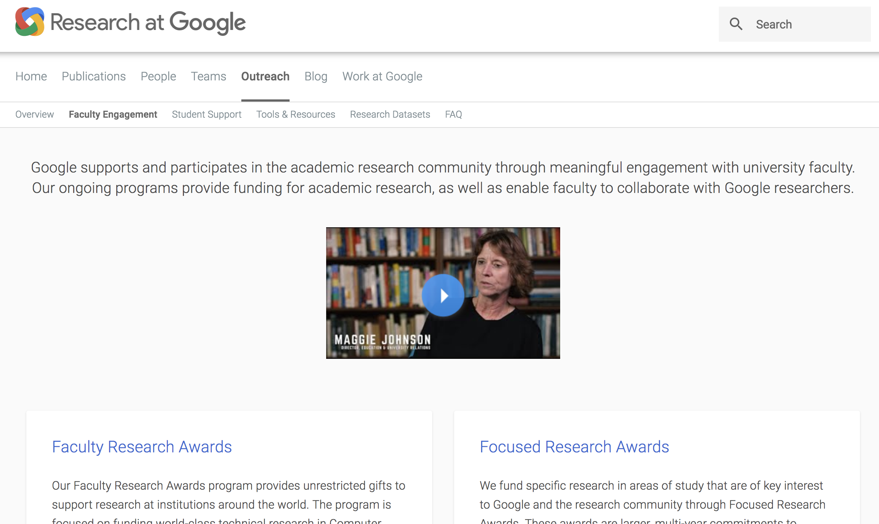
Notes:
I am not a Machine Learning researcher/expert.
My team manages the interface between research at Google, and external researchers, but largely in the computer science fields.
And what I’m hoping to have with you all is a conversation about how best to work with domain scientists, and to additionally leverage the NSF to do this in an effective and scalable way.

Slide 4
Possible Points of Leverage
Education
Data
Implementation

Slide 5
Education
Motivation
Machine Learning
ML Applicability

Slide 6
Data
What to gather
How much
How to store/access
Notes:
More data is only useful with careful design

Slide 7
Implementation
Experiment Design
ML Implementation
Tools

Slide 8
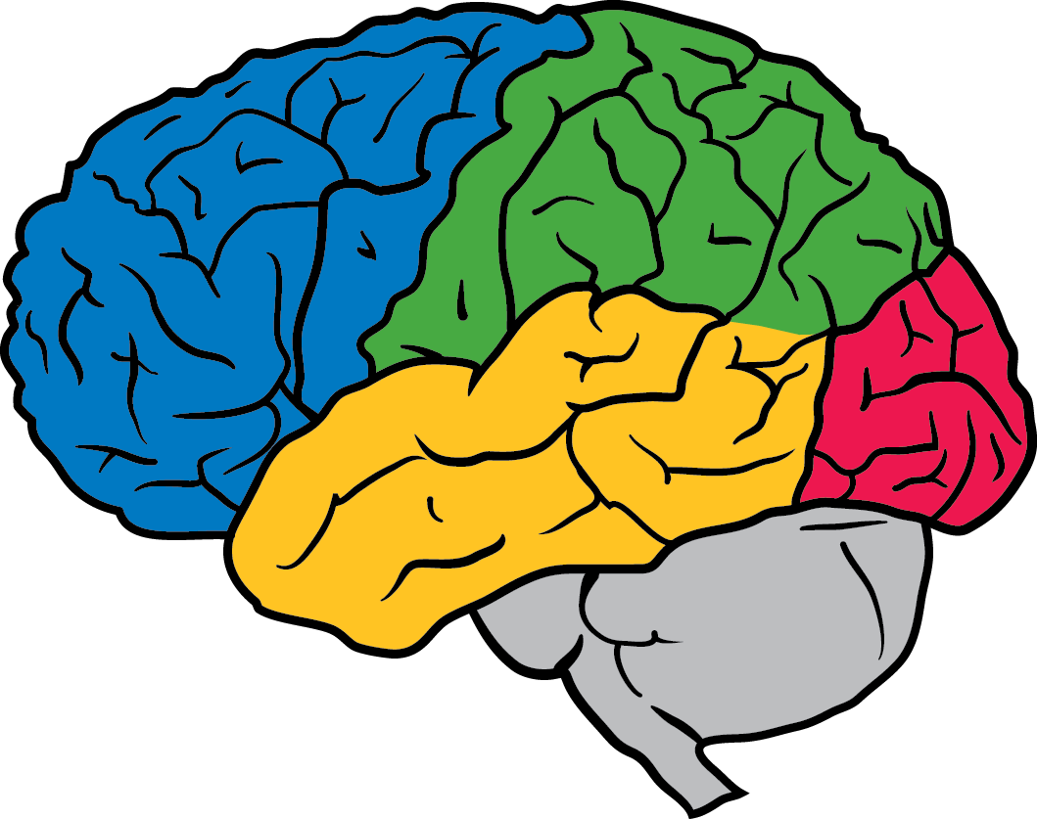
Broad Toolkit of Alphabet Technologies
Machine learning
Deep Learning
Visual search
Sequence prediction
Logistic regression at scale
Other systems implementing almost every ML algorithm
Scale
Cloud, DataFlow
Borg for billions of core hours
Imaging
Tech from Geo, Search, Photos, Android
Ongoing research
Experiment design
Parameter tuning via batched experimental design
DOE modeling

Slide 9
So Far

Slide 10
Education @ NSF Meetings
May 2017 Materials Workshop
July 2017 Quantum Science Summer School Machine Learning Crash Course 15 hour course -> 3 hours + optional consulting

Slide 11
Google Accelerated Sciences Team
Increase the rate of scientific discovery by leveraging Google’s extensive knowledge and technology
Projects should have
Science upside: large scientific/humanitarian benefit.
World class partners: deep understanding and desire to collaborate.
Unique leverage: of Google algorithmic expertise and large scale.
Business upside: revolutionize an important industry.
What success looks like
Participate and ‘ship’ important breakthroughs
Transform science via development and sharing of exemplary research methods
Structure: 2-4 Googlers working with scientists to combine domain knowledge & specific Google expertise

Slide 12
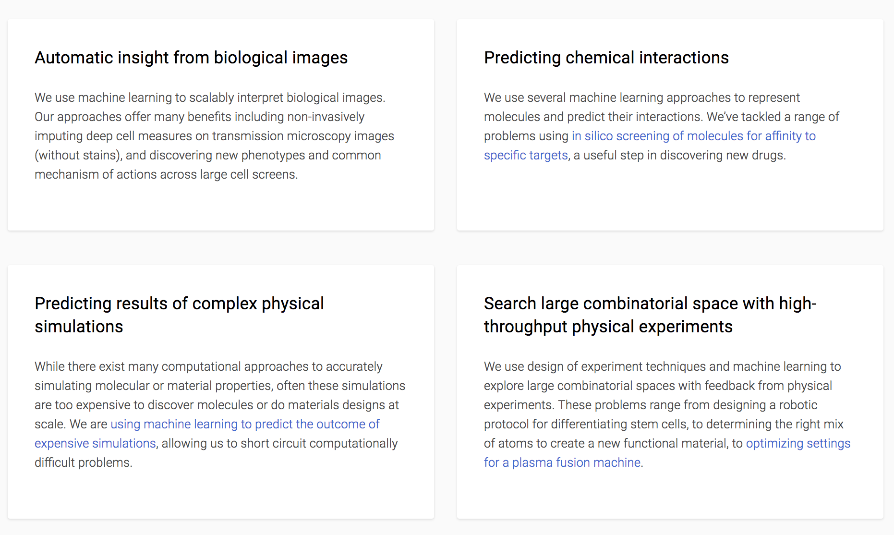

Slide 13
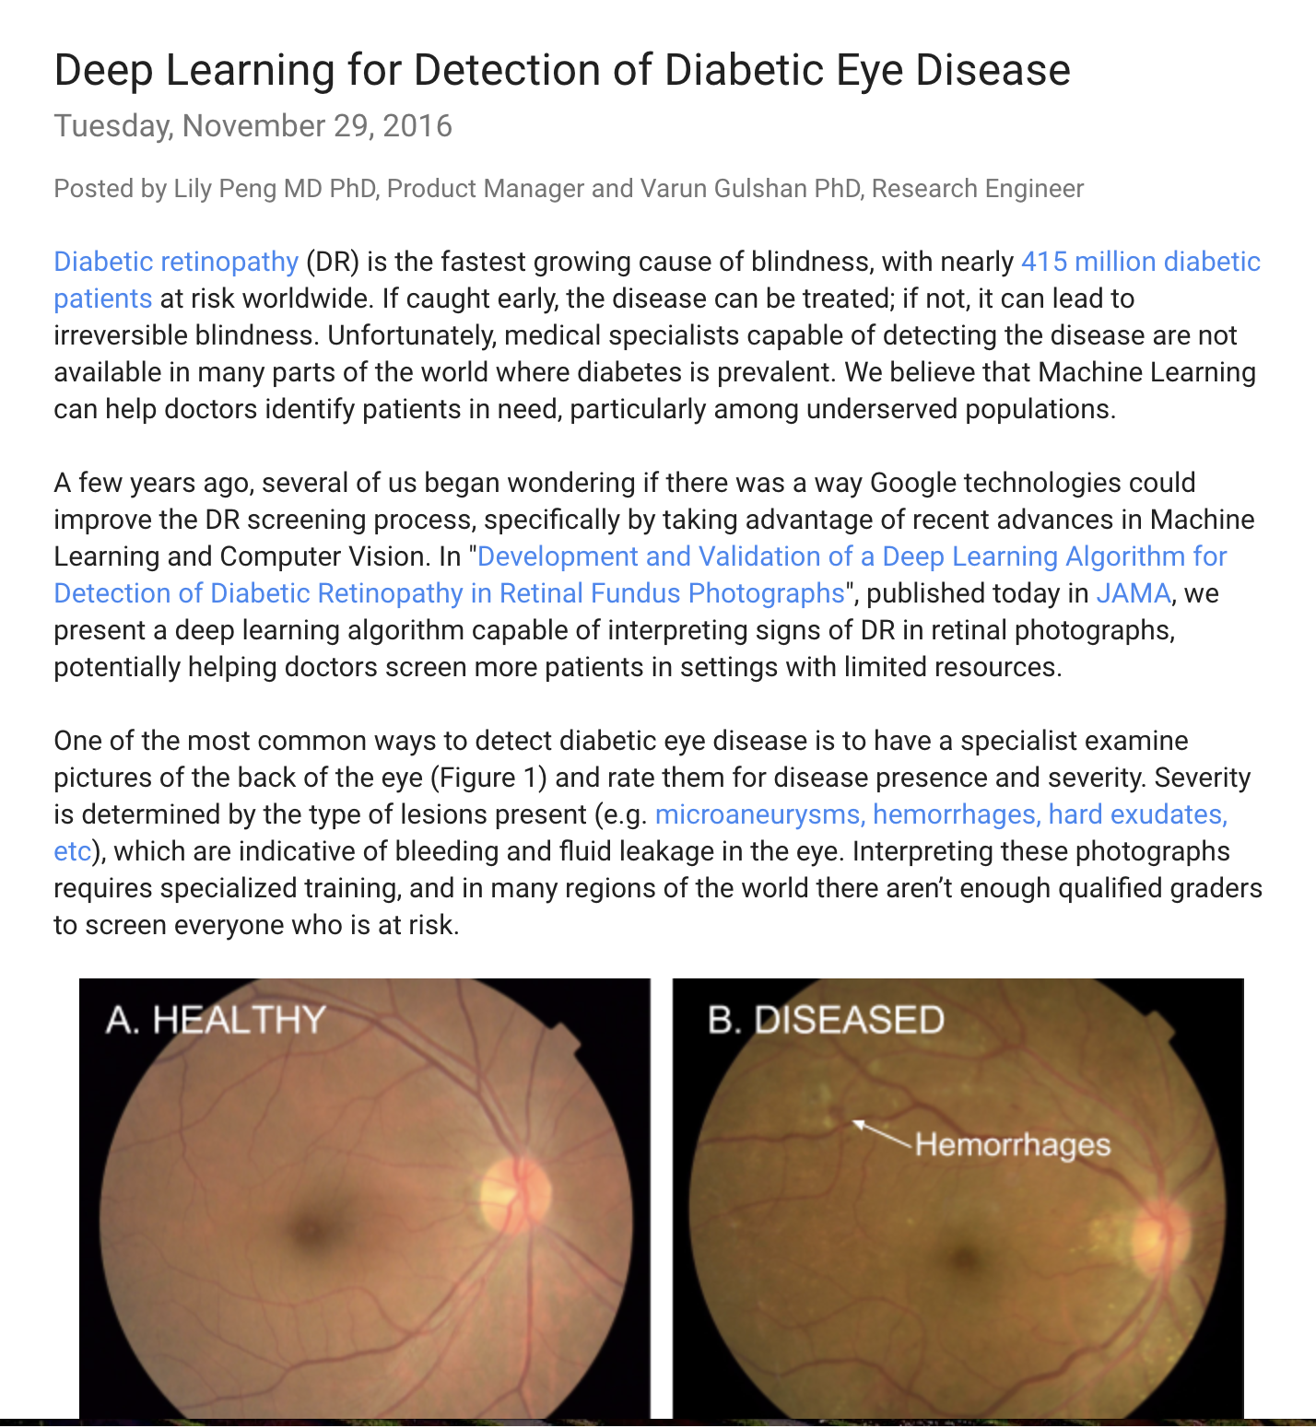

Slide 15
NSF BIGDATA
Critical Techniques, Technologies and Methodologies for Advancing Foundations and Applications of Big Data Sciences and Engineering
SYNOPSIS
The BIGDATA program seeks novel approaches in computer science, statistics, computational science, and mathematics, along with innovative applications in domain science, including social and behavioral sciences, education, biology, the physical sciences, and engineering that lead towards the further development of the interdisciplinary field of data science.
Notes:
Downside: have to be far along on the Education/data/Implementation curve to take advantage

Slide 16
Discussion
What is most needed?
What are the barriers?
What can domain scientists take advantage of?
What can uniquely be offered by NSF+Google?

