Slide 1
PREM AND MRSEC DIRECTORS MEETING
Alexandria, October 2017

Slide 2
Expectation in PREM
Increase diversity through Materials Research.

Slide 3
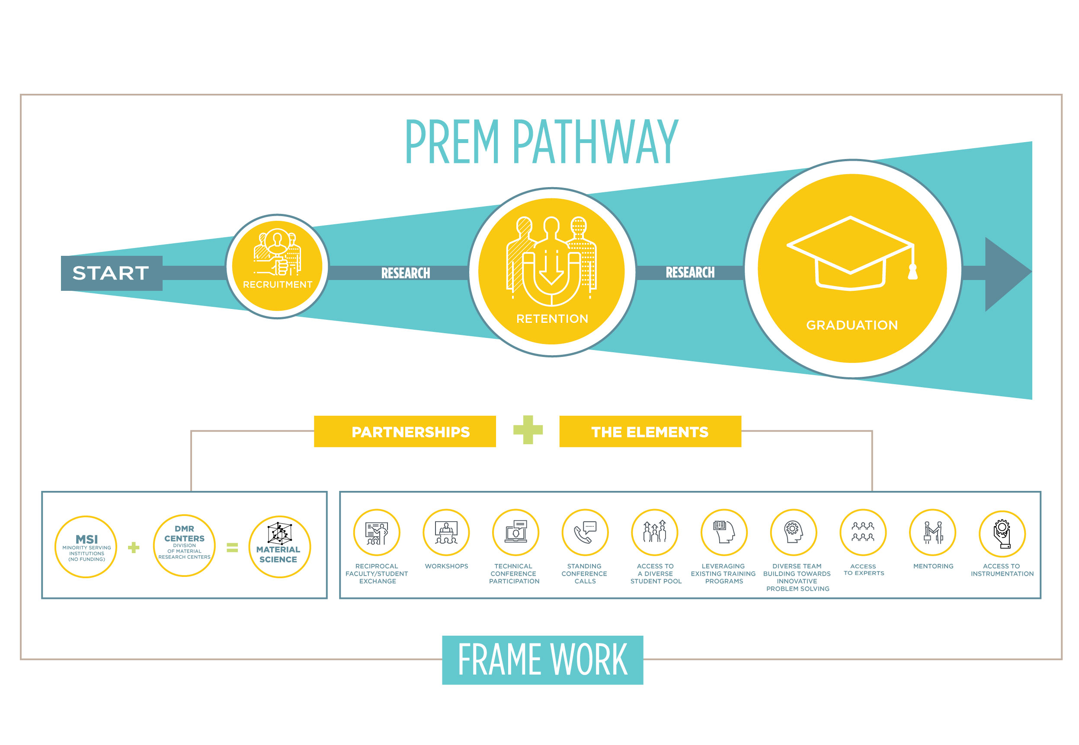
Notes:
Methodology – Introducing the PREM FRAMEWORK: a schematic allowing to describe all PREMs, regarding of their starting point, i.e. the research capacity and diversity efforts.

Slide 4
The PREM Pathway maps the evolution of diversity efforts.
Each Partnership context is defined by an initial point along the Pathway.

Slide 5
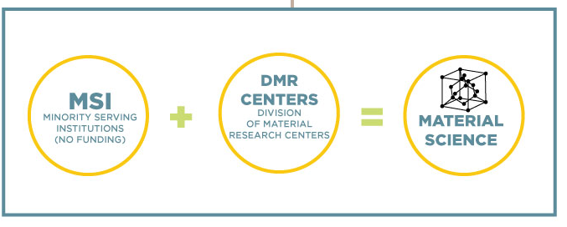
The Partnership
The Partnership is formed by MSI and DMR Centers and Facilities.

Slide 6
The Elements
The Partnership designs adequate research and education Elements to propel participants through the Pathway.

Slide 7
Outcome
Increased diversity and research & education output.

Slide 8
Evaluation/Assessment
The importance of context: it sets up the criteria for evaluation.
A variety of initial contexts in terms of research capacity and position on the Pathway can lead to very successful PREMs:
UT El Paso
UPR Humacao
An initial description in the proposal will be further refined upon award.
Questions to consider:
Where are we now?
How can we contribute to the Pathway?
Where are we going to be in 6 years?
How are we going to get there?

Slide 9
Current
Previous
6 year award.
PREM Framework as a common platform where to map all projects.
Student/faculty exchange plan between partners as well as student mentoring- mandatory.
Project Description page limit- 28 pages.
Native American-serving non-Tribal Institutions
The partnering institution Co-PI to be the Director of the Division of Materials Research (DMR)-supported center or facility.
Detailed DMR Centers and Facilities.
Research and education partnership contributing to increase the quantity and quality of research and education at the minority-serving institution.
Existing or recently identified common interests.
Partnership Context-Multiplicity of starting points.
Flexibility in evaluation and assessment plans in diversity and scientific output.
Plans to evaluate diversity enhancement in the partner institution.
5 year award.
Multiple descriptions due to the rich PREM landscape.
Student/faculty exchange plan between partners as well as student mentoring.
Project Description page limit- 20 pages.

Slide 10
Notes:
Methodology – Introducing the PREM FRAMEWORK: a schematic allowing to describe all PREMs, regarding of their starting point, i.e. the research capacity and diversity efforts.

