Slide 1
MRSEC Education/Recruiting/Outreach Activities
Kristin Dreyer (Pennsylvania State University)
Michelle McCombs (Ohio State University)

Slide 2
Our 2016-2017 Priorities
NSF MRSEC Visibility & Awareness (with DMR)
MRS Fall Meeting
APS March Meeting
NSF MRSEC Website
Improving Diversity Recruitment
IMRC (supplement awarded to Northwestern)
SACNAS
Annual Meeting Joint Session at new NSF

Slide 3
NSF MRSEC Visibility & Awareness
Conference Booths (in partnership with DMR Booth)
MRS Fall Meeting
APS March Meeting
Why Faculty volunteers?
Audience is faculty, postdocs, senior-level grads, and DMR Program Officers
Questions are related to research interests, proposals, strategic interdisciplinary planning
The MRSEC Elevator Pitch
Notes:
The NSF MRSEC program is the premier interdisciplinary materials research effort in the nation with a long history of excellence in the field.
It is a privilege to be part of it ....
NSF Program officers need our support... In addition to overseeing the program, they have to continue to advocate for its existence.
The only way policy makers, industry leaders, teachers, voters will know about the MRSEC program is if they are informed about it
Which means that the materials community itself needs to be aware.
Therefore, responsibility to make sure all members of the materials community know about the program.
Another idea: Suggestion for the acknowledgement / thank you slide... What is the MRSEC?
To be handled by the Communication & Coordination Committee

Slide 4
Communication & Coordination Committee
MRS Fall Meeting (Boston)
APS March Meeting (Los Angeles)

Slide 5
Diversity Recruitment
Conference Booths
IMRC (led by Northwestern)
SACNAS
. Why Education Director volunteers?
Audience is primarily undergrads, masters, grads, and postdocs
Questions are related to general research topics, summer programs, grad school, postdoc positions, and how to apply
The MRSEC Elevator Pitch
Notes:
Pursuing a graduate degree or summer research at a university that has a MRSEC is a smart choice because the existence of a MRSEC means that there is a strong collaborative interdisciplinary culture, environment, and network which provides tremendous benefits to student researchers.
How do I apply to a MRSEC? (You don’t... Here’s how...)
Supplement Award – will pay for the booth itself; strategic planning will seek volunteer organizers who are already attending the conference
To be handled by the Recruitment & Retention Committee

Slide 6
Broadening Participation Committee
IMRC (Cancun, Mexico)
SACNAS (San Antonio, Texas)

Slide 7
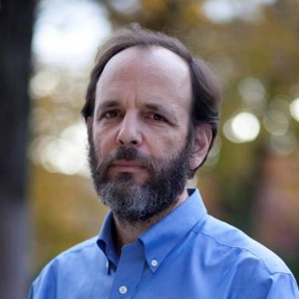
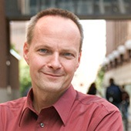
Joint Session: Sustainability
Daniel Sarewitz
Co-Director, Consortium for Science, Policy & Outcomes
Professor of Science and Society, School for the Future of Innovation in Society
Uwe Kortshagen
University of Minnesota MRSEC
James J. Ryan Professor
Distinguished McKnight University Professor
Mechanical Engineering Department Head

Slide 8
Thank you!

