Slide 1
NSF MRSEC Program mrsec.org mrfn.org
Division of Materials Research (DMR)
Materials Research Science and Engineering Centers (MRSEC)
October 10, 2017
Dan Finotello
National Science Foundation
MRSEC Directors and Education Directors Meeting

Slide 2
Thank you !!!!
Melissa Hines
Michael Rubner
Frank Wise
Geoffrey Beach
Daniel Gamelin (Christine Luscombe)
Nadya Mason
Edward Yu

Slide 3

DIVISION OF MATERIALS RESEARCH (DMR)
Topical Materials Programs
Centers & Teams
National Facilities & Instrumentation Program
Biomaterials
Ceramics
Electronic & Photonic Materials
Metals and Metallic Nanostructures
Polymers
Condensed Matter & Materials Theory
Condensed Matter Physics
Solid State and Materials Chemistry
Jul 2019
Materials Research Science & Engineering Centers (MRSEC)
Cornell High Energy Synchrotron Source (CHESS)
National High Magnetic Field Laboratory (NHMFL)
Center for High Resolution
Neutron Scattering (CHRNS)
National Nanotechnology
Coordination Network (NNCI)
Materials Innovation Platforms (MIP)
Unsolicited Proposals, EAGER, RUI, GOALI (and CAREER*)
Partnerships in Research & Education in Materials (PREM)
Jan 2018
Cross-Cutting Activities
Diversity
International
Education
Jan 2019
Designing Materials to Revolutionize & Engineer our Future (DMREF)
User Facilities
Solicitations

Slide 4



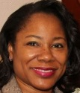


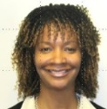





















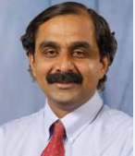

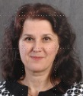




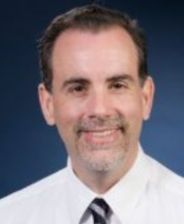


Division of Materials Research (DMR)
Administrative Workflow
Linda Sapochak, DD
Sean L. Jones, DDD
Velma Lawson, PSM
Neila Odom-Jefferson, OS
Vacant
Allison Smith, PS
Denese Williams, PA
Elaine Washington, PS
Meghan Ackerman, PS
Benita Fair, PS
Renee Ivey, PS
Aubrie TenEyck,
Contractor
Claudia Johnson, Contractor
Student
PA
Recruitment Mgt. Support
Program Budget
CGIs
IAAs
Data Analysis
DMR Highlights
Refreshment Orders
Panel Spreadsheet
IAA
Admin Review
DMR Highlights
Outreach
Program Budget
CGIs
Admin Review
Order Supplies
Backup Timekeeper
Program Budget
CGIs
Admin Review
Technology Trainer
Web Updates
Listserv
Outreach
Admin Review
Timekeeper
Order Supplies
IAA
Program Budget
CGIs
Equip. Excess
Program Budget
CGIs
IAAs
Record Retirement
Program Budget
CGIs
IAAs
Record Retirement
Program Budget
CGIs
IAAs
COV
IT Support
Data Analysis
Trainer
M
National Facilities
Designing Materials to Revolutionize and Eng. Our Future
Materials Research Science & Eng. Centers
Electronic & Phonic Materials
Condensed Matter & Materials Theory
Polymers
Biomaterials
Ceramics
Metals & Metallic Nanostructures
INT
XC
XC
NIST
I-Corps
Guebre Tessema
John Schlueter
Daniele Finotello
BSF
XC
Daryl Hess
Andrew Lovinger
Alex Simonian
Lynnette Madsen
Miriam Deutsch
XC
NANO
Gary Shiflet
MIP
Solid-State & Materials Chemistry
Charles Ying
SNM
QL
Alex Klironomos
Eva Campo
Mohan Srinivasarao
Condensed Matter Physics
Mohan Srinivasarao
DMR Initiatives
BSF - Binational Science Foundation
I-Corps - Innovation Corps
INT - International
QL - Quantum Leap
MIP - Materials Innovation Platforms
MRI - Major Research Instrumentation
NANO - Nanotechnology
NIST - National Institute of Standards &
Technology
NSCI - National Strategic Computing
Initiative
SNM - Scalable Nanomanufacturing
XC - Cross-Cutting Activities
MRI
Tania Paskova
REU Sites
PREM
NSCI
QL
XC
Birgit Schwenzer
Leonard Spinu
XC
Tomasz Durakiewicz
Jose Alfredo Caro
Jose Alfredo Caro
XC
XC
Eugene Zubarev
Expert
Germano Iannacchione
Freddy Khoury
Eva Campo

Slide 5
MRSEC Program Goals / Achievements
Stimulate and support outstanding interdisciplinary research and education in materials of a scope and complexity needing a center.
All students, in or out of MRSEC benefit from it; network. Curriculum development. No departmental (jargon) barriers.
Critical mass of investigators of complementary/diverse expertise addressing fundamental, complex materials problems that are intellectually challenging and important to society.
Foster partnerships between academia, industry, National labs, and international: Convergence / Transdisciplinarity
Re-competition model and Seed program provide a mechanism for reinvention and adaptation to address emerging areas (flexibility)
Leveraging of funds (NSF ~$56M; $44M other sources; Start-ups (10/year); Patents (50/year). Jobs creation
Materials Research Facilities Network (~ 10 years), www.mrfn.org

Slide 6
MRSEC: Forever Convergence https://www.nsf.gov/od/oia/convergence/index.jsp
Convergence is the deep integration of disciplines to form a new and expanded framework for addressing scientific and societal problems. It is related to other terms used to capture the concept of research that spans disciplines: transdisciplinary, interdisciplinary, and multidisciplinary. While the latter terms have taken on established meanings in the research literature, the characterization of convergence is still evolving. Convergent research is most closely linked to transdisciplinary research in its merging of distinct and diverse approaches into a unified whole to foster new paradigms or domains.
NSF identifies convergence with two primary characteristics:
Deep integration across disciplines. As disciplines interact, the knowledge, theories, methods, data, research communities and languages are increasingly intermingled or integrated. On occasion, new disciplines form from sustained integration across disciplines. Through this deep integration, new frameworks and paradigms are created that enable new solutions. While it is not a specific objective of NSF’s efforts to promote convergence, new disciplines sometimes emerge from such sustained interactions across disciplines.
Driven by a specific and compelling problem. Convergent research is generally inspired by the need to solve a specific problem, whether it arises from a deep scientific challenge (e.g., what governs phenotype) or a pressing societal need (e.g., how do we enhance national security?). Definitions of convergent science often invoke grand challenges or wicked problems as a primary driver of such deep integration.

Slide 7
21 MRSECs Expenditures 2017
% of Fixed Total Budget, $56 M/yr
Majority of Research funds (IRGs + Seeds) pay for Graduate student and Post-doc stipends.

Slide 8














High Impact & Networking more than 2200 yearly Participants
21 MRSECs (2017)
56 IRGs
1221 publications (42.3% 2+ authors; 5YA: 40.1%)(range 20.7% to 68.2%; 7 >50%)
65 patents awarded (50/year)
21 MRSEC (2017)
783 (606) supported TTF participants (20-26%F; 6-7%URM); 24% PHY, 20.3% CHE, 17.5% MS, 27% EE & CE &ME
862 GS (28% F, 8.7% URM; 5YA: 815/Y 26.4% F, 7.2% URM)
190 UGS (39.5% F, 14.2% URM)
306 Post-docs (18.6% F, 3.9% URM; 5YA: 290/Y; 22.4% F, 6.4% URM)

Slide 9
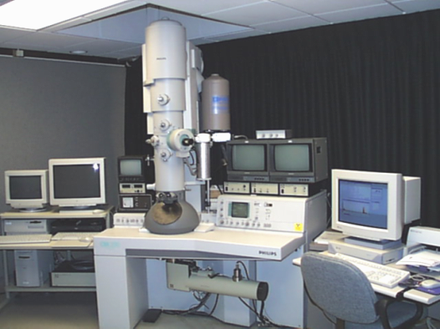
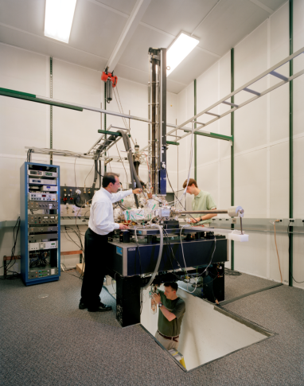
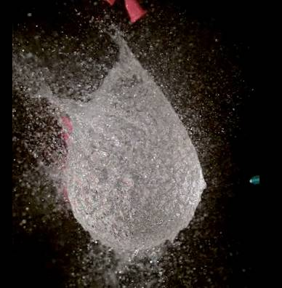
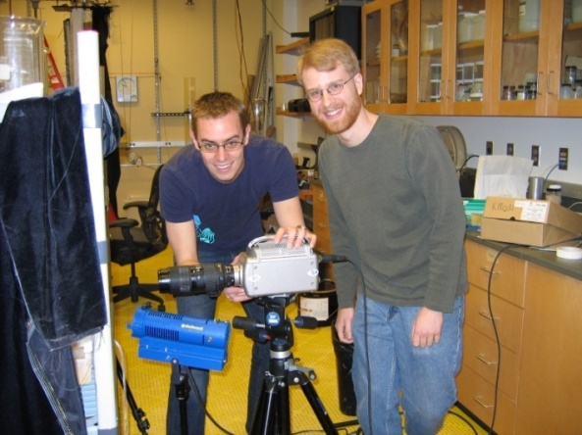

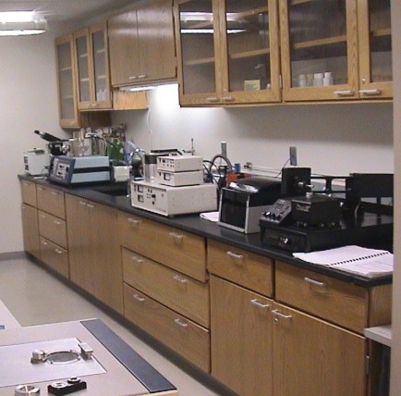

Infrastructure mrfn.org/instruments
>1140 Instruments
MRFN Statistics
23 centers
1141 instruments
262 experts
Recently added instruments
Thermogravimetric Analyzer
Thermogravimetric Analyzer Mass Spectrometer
Yearly Users of MRSEC Facilities (non MRSEC Participants)
  > 1455 Academic
  > 703 Industry
  >48 National Labs
823 Publications acknowledged MRSEC SF in 2017
62 MRSEC Technical Staff in SEFs
34 Other Technicians
52 Administrative Staff
39 Education Staff

Slide 10


























Innovation
MRSEC Startup Companies
Since 1985: 156 (99 since 2008) companies in 22 states plus 5 abroad employing ~ 2600 individuals; More than 1500 patents awarded

Slide 11
2016 MRSEC Competition: 2 or 3 IRGs
Solicitation Published: March, 2016
Pre-Proposals Due Date: July 1, 2016
  Panels evaluated IRGs
  Panels: 7-8 panels, September 7 – 30, 2016
  Full Proposal Invitations: October 6, 2016
Full Proposals Due Date: December 2, 2016
  Mail Review
Reverse Site Visits:
  Invitations: Mid March 2017
  Panels: Mid April to 1st week in May 2017
  Recommendations To NSF/DGA: First week in June
  Awards announced September 14, 2017

Slide 12
2016/2017 MRSEC Competition Outcomes
Received 80 MRSEC preliminary proposals including 221 IRGs by July 1, 2016. 5 preliminary proposals were Returned Without Review (RWR): research not aligned with DMR
The 75 MRSEC preliminary center proposals included 206 IRGs and were separated into 7 interdisciplinary topical panels (25-35 IRGs per panel) and reviewed by a total of 100 panelists. Overall a total 885 reviews were received, or, an average of 4.3 reviews per IRG.
18 Full Proposal were recommended for submission; they included 43 IRGs.

Slide 13
2016/2017 MRSEC Competition Outcomes
Full Proposals: Evaluation of 252 IRG separate reviews (6 independent reviews per IRG) provided by >120 reviewers. The MRSEC program recommended to invite 10 MRSEC proposals with 26 IRGs to the April/May 2017 reverse site visits (RSV).
Five RSV Panels each reviewed 2 proposals. A total of 41 panelists participated.
8 MRSEC submissions including 19 IRGs were recommended for funding.
Current MRSEC Status: 20 Centers with 51 IRGs

Slide 14
Sept. 14, 2017: 20 MRSEC 51 IRGs
CLASS of 2014
12 Awards, 32 IRGs: Brandeis, Chicago, Colorado, Columbia, Harvard, Minnesota, MIT, Nebraska, NYU, Ohio State, Penn State, Princeton.
CLASS of 2017
8 Awards, 19 IRGs: Cornell, Northwestern, UC Santa Barbara, U Penn, U Texas-Austin, U Washington, U of Illinois, U of Wisconsin.
https://mrsec.org/news/nsf-announces-new-awards-materials-science-and-engineering-centers
https://mrsec.org/centers (REVISED BROCHURES NEEDED)

Slide 15
Class of 2017: 8 MRSEC 19 IRGs
CLASS of 2017
Cornell, Northwestern, UC Santa Barbara, U Penn, U Texas-Austin, U Washington, U of Illinois, U of Wisconsin.

Slide 16
MRSEC through the years

Slide 17
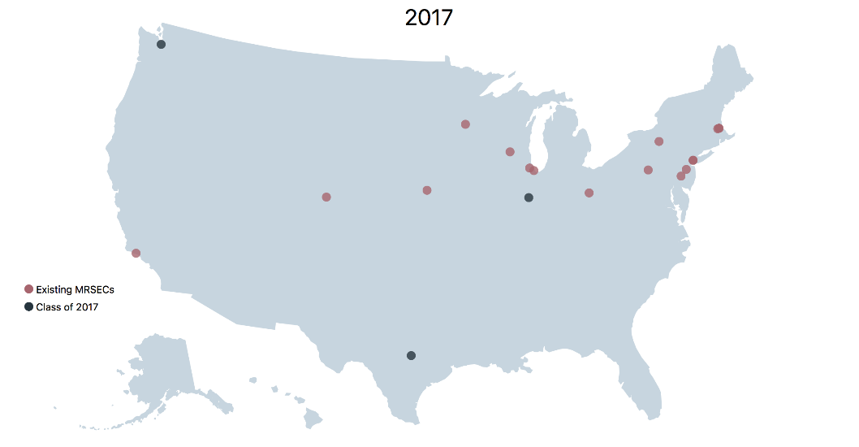
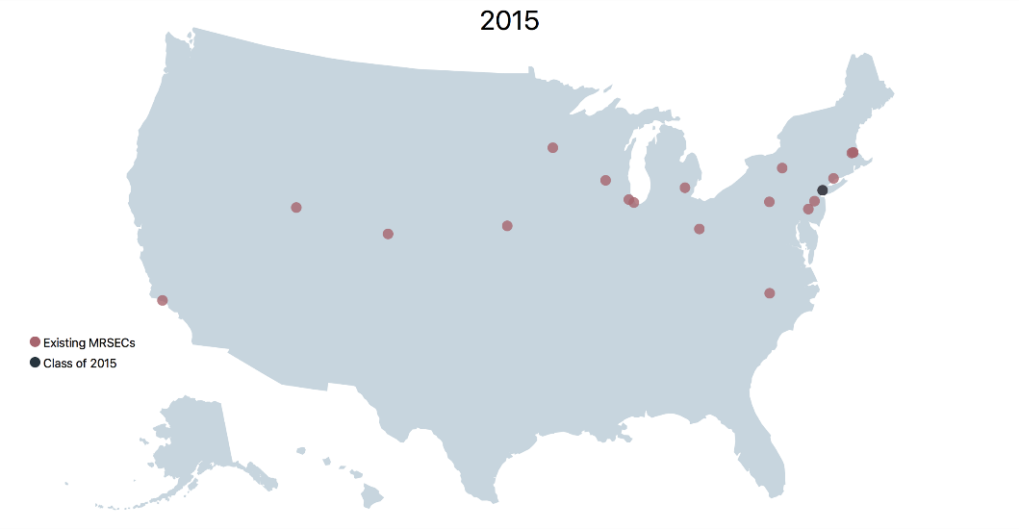
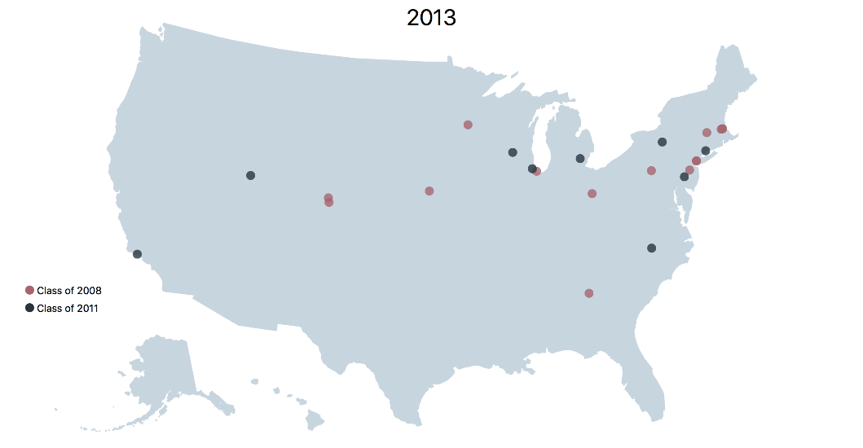
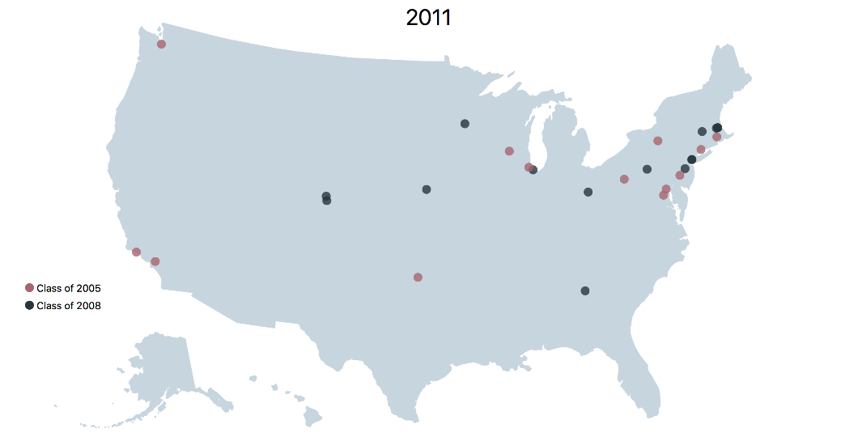
MRSEC Locations Through the Years

Slide 18
MRSEC Activities in 2017 - 2018
MRSEC Legacy / Major Accomplishments / Visibility
MRFN Workshop
March 9-10, 2018 @ UCSB
Ram Seshadri, Mark Hersam, Ali Yazdani and Nadya Mason
Fourth Year Site Visits
12 Visits from April 9 till June 15, 2018

Slide 19
The 2017-2018 MRSEC Team
Birgit | Miriam | Mohan | Leonard | Dan
Columbia | Ohio State | Brandeis | Nebraska | Chicago
NYU | Princeton | Colorado |  | Harvard
Northwestern | Washington | Minnesota |  | MIT
 |  | U Penn |  | Penn State
 |  |  |  | Cornell
 |  |  |  | UCSB
 |  |  |  | UT Austin
2 IRGs = 5 Panelists | 3 IRGs = 7 Panelists |  |  | Wisconsin
 |  |  |  | UIUC

Slide 20
2017-2018 MRSEC: 4th Year Site Visits
POC
4/9-4/10 | M T | Nebraska | Leonard | Dan
4/12-4/13 | Th F | Colorado | Mohan | Dan
4/18-4/19 | W Th | Columbia | Birgit | Dan
4/23-4/24 | M T | Penn State | Dan | Leonard
4/26-4/27 | Th F | Princeton | Miriam | Dan
5/1-5/2 | T W | Minnesota | Mohan | Dan
5/7-5/8 | M T | Harvard | Dan | Germano
5/14-5/15 | M T | Brandeis | Mohan | Dan
5/17-5/18 | Th F | MIT | Dan | Alexios
5/24-5/25 | Th F | Ohio State | Miriam | Dan
5/30-5/31 | W Th | Chicago | Dan | Tomasz
6/14-6/15 | Th F | NYU | Birgit | Dan

Slide 21
2019-2020 MRSEC Competition
Tentative Dates
Solicitation: February/March, 2019
Pre-Proposals Due Date: June 27 - July 1-2, 2019
Full Proposals Due Date: December 2-6, 2020
Reverse Site Visits: April/May, 2020

Slide 22
Next MRSEC Directors Meeting
October 16, 2018
NSF Alexandria

