Slide 1
For Internet Access see Bill Daniels

Slide 2
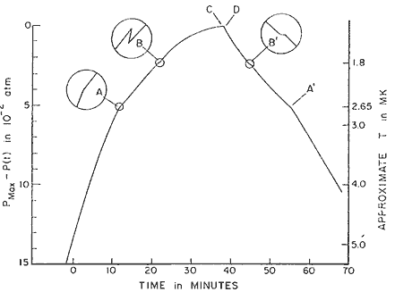
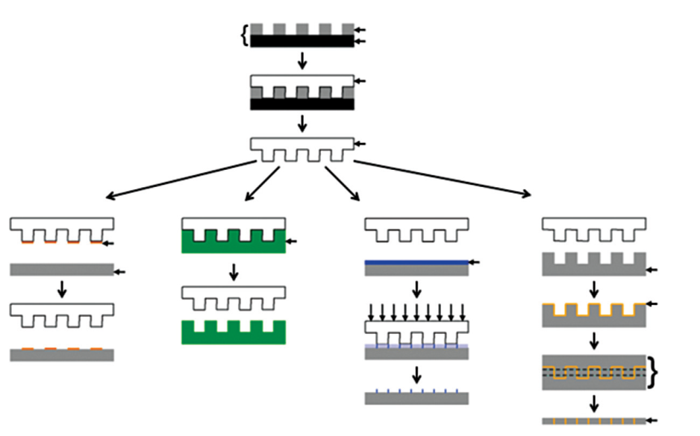
2013 Spring MRSEC Directors’ Meeting: ‘Materials Research Centers Legacy’
Charles Bouldin, Sean Jones, Charles Ying
MRSEC Program Directors
1996 Nobel Prize in Physics “for their discovery of superfluidity in helium-3,” David M. Lee, Douglas D. Osheroff, and Robert C. Richardson – Cornell MRSEC
Creation of Soft Lithography
Whitesides – Harvard MRSEC

Slide 3
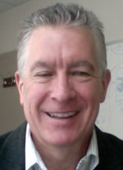
New MRSEC Program Director
Charles Bouldin

Slide 4
Programmatic Updates
Class of 2008 Site Visits completed.
10 of 14 after last Directors’ Meeting
Class of 2011 Site Visits underway
5 of 9 completed
2013 Education Coordinators’ Meeting
Sept.16, 2013, Santa Barbara, CA
MRSEC Competition begins August 26, 2013
Class of 2009 PREM Reverse Site Visits in 2013
8 of 8 completed
Next PREM Competition Spring 2015

Slide 5
Programmatic Updates
Lens of the Market
MRSEC to provide opportunity for 1-day workshop designed for each center to better inform students how to translate research into commercialized products.
Could be considered pre- i-Corps experience.
Interested?
Research.gov and Annual/Final Reports
Slow start with new system, but NSF working on the bugs.
Will require a different method of capturing data, specifically demographic information.
Planning on utilizing mrsec.org for data capture in response to the self reporting requirements. Chuck to work with Irina on solutions. Please be patient as we work with NSF policy to be compliant.

Slide 6
2014 MRSEC Competition
Pre-proposals due August 26, 2013
Topics are sought that solve fundamental, timely and complex materials problems that are intellectually challenging, important to society, and that potentially broaden the current portfolio.
Preliminary proposals will be reviewed based on the topical areas of IRGs, thus the IRGs in a MRSEC proposal may be reviewed by different panels if the research areas are dissimilar.
A MRSEC preliminary proposal with two or more IRGs of lower quality, as determined by the preliminary proposal review, would normally not be invited for a full MRSEC proposal.
Full proposals due January 10, 2014
How can you help?
Serve as a reviewer and encourage colleagues/center participants to do the same.
For those submitting proposals, strictly adhere to the GPG!

Slide 7
Return Without Review
The proposal:
1. is inappropriate for funding by the National Science Foundation;
2. is submitted with insufficient lead-time before the activity is scheduled to begin;
3. is a full proposal that was submitted by a proposer that has received a “not invited” response to the submission of a preliminary proposal;
4. is a duplicate of, or substantially similar to, a proposal already under consideration by NSF from the same submitter;
5. does not meet NSF proposal preparation requirements, such as page limitations, formatting instructions, and electronic submission, as specified in the Grant Proposal Guide or program solicitation;
6. is not responsive to the GPG or program announcement/solicitation;
7. does not meet an announced proposal deadline date;
8. was previously reviewed and declined and has not been substantially revised; and
9. duplicates another proposal that was already awarded.
Proposals that do not separately address both merit review criteria within the one-page Project Summary will be returned without review.
Be aware: Automatic Compliance Checking is in effect, see NSF 13-066
BEST ADVICE: REVIEW Page limits, References, and Bio Sketches thoroughly! Common errors are missing titles and et al in references, missing advisors in Bio Sketches (including deceased), and more than 10 publications listed on Bio Sketch, and project description missing prior results for PI and Co-PIs.

Slide 8
History of the MRSEC Program
NSF established DMR
IDL
MRL
MRSEC
MRG
1960
1972
1984
1994
Engineering Res Centers
1985
Science & Tech Centers
1989
Nanoscale Science & Engineering Centers
NSEC
2001
Physics Frontier Centers
PFC
2002
Centers for Chemical Innovation
CCI
2004

Slide 9
Questions?

