Slide 1
Materials Research Facilities Network
Your Partner for Materials Characterization

Slide 2
Materials Research Facilities Network
Shared Experimental Facilities at 25 MRSECs
Over 250 companies
Small
Companies
K-12
Outreach
Over 200 Universities and Colleges
Large
Companies
Graduate
Students
National
Laboratories
Undergraduate
Institutions
Undergraduate
Students
Minority-serving
Institutions
Over 3000 Publications and Patents
Over 7000 Unique Users
Expansion to PREM centers in 2014

Slide 3
MRFN.org
Notes:
MRL shared equipment facilities (SEFs) continue to have an exceptional impact on the broader research community at UCSB, and are influenced and supported by UCSB’s support of the Materials Research Facilities Network (MRFN). The MRL has continued to drive and champion the MRFN since its inception in 2007. Dr. Amorette Getty, continuing as MRFN coordinator, provides oversight of local MRFN activities and acts as a central point-of-contact for external user relationships, as well as providing leadership and a central contact point for other MRFN efforts. This year the major focus of the MRFN has been the redevelopment of its online tool set at MRFN.org. The new website has tight integration with the MRSEC.org website and capability for integration with member websites as well, and hosts a comprehensive database of the instrumentation housed in MRFN-member SEFs across the country, as well as the technical personnel which support these facilities. These upgrades support enhanced collaboration and networking ability of researchers as well as technical staff at the nation’s Materials SEFs, and website development will remain a key component of central MRFN activities for the coming year.

Slide 4
300MHz SWB MRI, Rheology, Diffusion, and Solid-state NMR
One of 3 in the world:
Non-invasive imaging of interiors and exteriors
Diffusion of molecules/ions in solids and solutions,
Fluid and soft material flow and rheology
Low and elevated temperatures
Sept, 2012: Half-Day Mini-Symposium
Introduced the instrument to the campus community; 40+ attendees from 6 departments
Guests from 5 external institutions, incl. Montana State, Leibniz Institute, and Technical University Munich
Notes:
Spectroscopy Facility (Director: Han; Manager: Dr. J. Hu) brought online the newest of its 5 NMR spectrometers, a 300MHz SWB MRI, Rheology, Diffusion, and Solid-state NMR. This instrument, one of three similar in the world, allows non-invasive imaging of the interiors and exteriors of a wide range of materials, dedicated diffusion measurements of molecules/ions in both solution and solids, as well as studies of the flow and rheology of soft and fluid materials at both low and elevated temperatures. To introduce the new instrument to the campus community, a half-day Mini-Symposium on NMR Imaging and Rheology was organized in late September by Dr. Song-i Han, and brought together more than 40 attendees from six campus departments and five external and international institutions, including Montana State, the Leibniz Institute, and the Technical University Munich. Symposium presenters shared recent results in the field and highlighted the capabilities this instrument brings to the materials science community. A new state of the art 400MHz solid-state NMR spectrometer will be added to the facility, opening the avenue for future acquisition of a cutting edge DNP instrument for unprecedented sensitivity enhancement in the research of NMR.

Slide 5
MRFN: WHY???
White House Office of Science and Technology Policy
Improved access to scientific instrumentation as a means to jump start innovation
Critical component of the materials innovation infrastructure that needs to be built up for MGI to succeed
Resource for entrepreneurs, particularly startups and small businesses

Slide 6
MRFN: Sharing Experimental Facilities Effectively and Efficiently
Peer-to-peer rental - The rise of the sharing economy - On the internet, everything is for hire
Mar 9th 2013 The Economist

Slide 7
MRFN: Sharing Experimental Facilities Effectively and Efficiently
“Collaborative Consumption” – as a group can we
Increase transparency- What are the procedures for accessing each site/facility/instrument? What is the cost? Does IP remain with the user or does the university retain some or all rights?
Friendliness to startups- Are there policies that could be put into place to encourage and support startups and small businesses?
Need to track usage more effectively!!!

Slide 8
MRFN.org Next Steps
Promote MRFN.org to non-MRSEC graduate, undergraduate, and minority-serving programs via email campaign.

Slide 9
MRFN.org Next Steps
Promote MRFN.org to non-MRSEC graduate, undergraduate, and minority-serving programs via email campaign.
Enhance website capabilities for networking and information-sharing among technical staff at member SEFs
Pending additional funding for site development
Request guidance from NSF & member centers on desired next steps

Slide 10
Facilities Operation Manager - Northwestern
Best practices – significant increase in MRL productivity

Slide 11
MRFN.org Next Steps
Promote MRFN.org to non-MRSEC graduate, undergraduate, and minority-serving programs via email campaign.
Enhance website capabilities for networking and information-sharing among technical staff at member SEFs
Pending additional funding for site development
Request guidance from NSF & member centers on desired next steps
Continue curating/polishing content on MRFN.org instrument database, soliciting news items from member centers, etc.
Better usage feedback – annual statistics would benefit everyone

Slide 12
FOM Capabilities

Slide 13
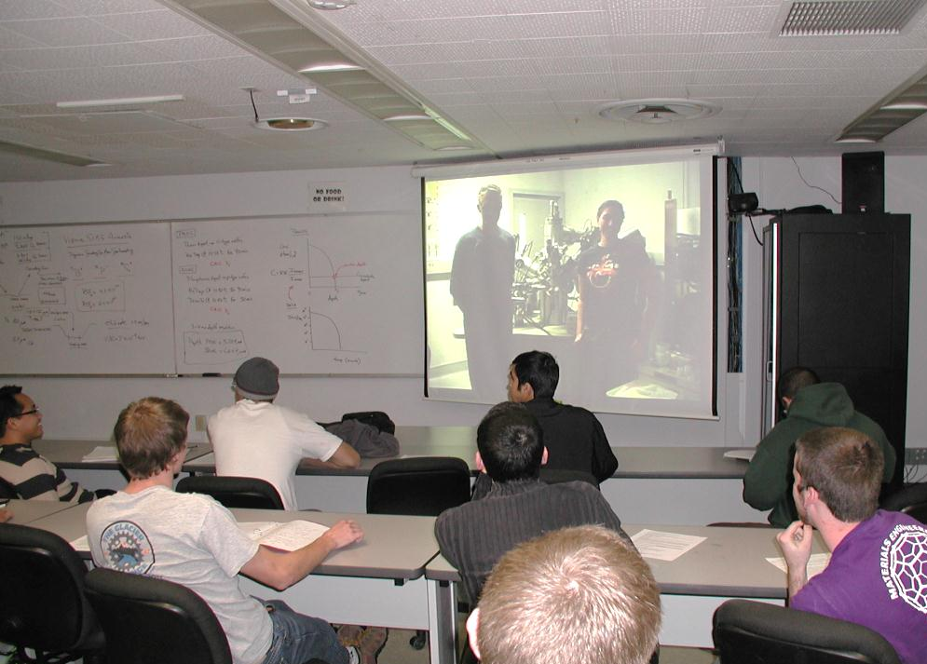
MRFN Virtual Lab Module: Year 3
Remote Learning Modules for Undergraduate Education
CalPoly SLO Virtual SIMS Lab Experience
Students prepare doped Silicon samples at CalPoly San Luis Obispo, and observe remotely while they are analyzed at the MRL via Secondary Ion Mass Spectroscopy by Dr. Tom Mates.
Supported by the MRFN @ UCSB

