Slide 1

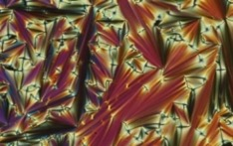
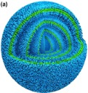
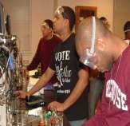
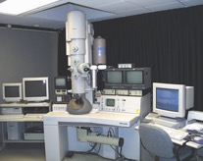
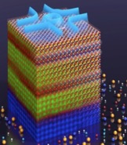
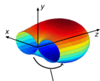
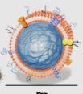
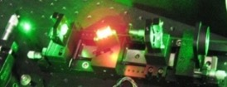
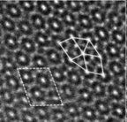


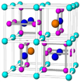
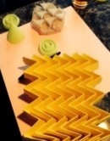
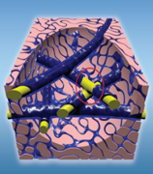
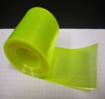

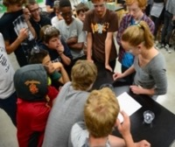
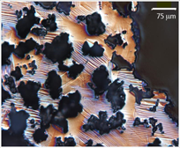
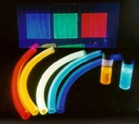
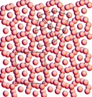




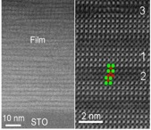
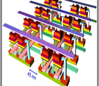



National Science Foundation (NSF)
Division of Materials Research (DMR)
Dan Finotello
Program Director
Materials Research Science and
Engineering Centers
National Science Foundation
Where Materials Begin & Society Benefits!
MRSEC Directors Meeting
Alexandria, VA
October 18, 2018

Slide 2
New Member(s)
Daniel Gamelin (Washington)
Paul Voyles (Wisconsin)
Marcus Weck (NYU)
Nick Abbott (Wisconsin)
Mike Ward (NYU)

Slide 3
The “Logo”

Slide 4







































Division of Materials Research (DMR)
Current Workflow
Linda Sapochak, DD
Clark Cooper, ADDD
Velma Lawson, PSM
Neila Odom-Jefferson, OS
Science Analyst
Allison Smith, PS
Recruiting
Recruiting, PS
Meghan Ackerman, Ps
Benita Fair, PS
Recruiting, PS
Aubrie TenEyck,
Contractor
Claudia Johnson, Contractor
Kelsey Smith, Student
Outreach
Recruitment Mgt. Support
Program Budget
CGIs
IAAs
Admin Review
Program Budget
CGIs
Standard Operating Procedures
Admin Review
DMR Highlights
Outreach
Program Budget
CGIs
Data Analysis
DMR Highlights
Refreshment Orders
Panel Spreadsheet
IAA
Admin Review
Technology Trainer
Web Updates
Listserv
Outreach
Timekeeper
Program Budget
CGIs
Panel Optimization
Program Budget
CGIs
IAAs
Record Management
Program Budget
CGIs
IAAs
Record Management
Newsletter
Outreach
Program Budget
CGIs
IAAs
Staff Meeting Coordinator
Krystle Wilson
Experts
National Facilities
Materials Research Science & Eng. Centers
Condensed Matter & Materials Theory
Polymers
Biomaterials
Electronic & Phonic Materials
Metals & Metallic Nanostructures
M
Designing Materials to Revolutionize and Eng. Our Future
Condensed Matter Physics
Freddy Khoury
NSCI
QL
XC
XC
NIST
I-Corps
Daniele Finotello
Guebre Tessema
John Schlueter
Daryl Hess
Tomasz Durakiewicz
Andrew Lovinger
Mohan Srinivasarao
SNM
QL
Gary Shiflet
Atul Parikh
MIP
PREM
INFEWS
Solid-State & Materials Chemistry
Tania Paskova
Charles Ying
Alex Klironomos
Germano Iannacchione
Eva Campo
Ceramics
Recruiting
MRI
REU Sites
Debasis Majumdar
Robert Opila
DMR Initiatives
BSF - Binational Science Foundation
I-Corps - Innovation Corps
INT - International
QL - Quantum Leap
MIP - Materials Innovation Platforms
MRI - Major Research Instrumentation
NANO - Nanotechnology
NIST - National Institute of Standards & Technology
NSCI - National Strategic Computing
Initiative
SNM - Scalable Nanomanufacturing
XC - Cross-Cutting Activities
Leonard Spinu
Birgit Schwenzer
Lynnette Madsen
XC
NANO
Lynnette Madsen
Catherine Oertel

Slide 5
20 MRSECs Expenditures 5/2018
% of Spent Budget, $44 M
Majority of Research funds (IRGs + Seeds) pay for Grad student and Post-doc stipends. MRSEC Total Budget $56M

Slide 6








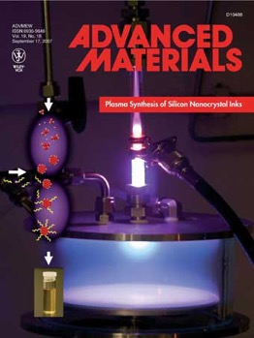





High Impact
20 MRSECs (2018) Output
51 IRGs
676 IRG publications (39.3% 2+ authors; range 21%-61%); 65 SEED publications. (+401 pubs from closing or NCE Centers)
1.02 all (1.32 nsf) pubs/part/report (1.82 for 12 MRSEC; range 0.85-2.84).(1.96 for 21 Centers in 2017)
35 patents awarded; 40 patents licensed; 12 startups
20 MRSEC (2018) Diversity
723 (563 NSF supported participants) (23%F; 5.8% URM)
268 Post-docs (25.7% F, 4.9% URM)
673 GS (30.5% F, 7.4% URM)
167 UGS (40.1% F, 22.2% URM)

Slide 7

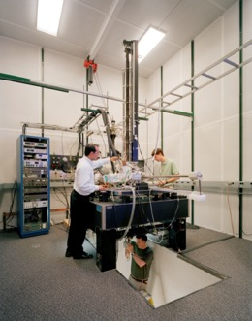
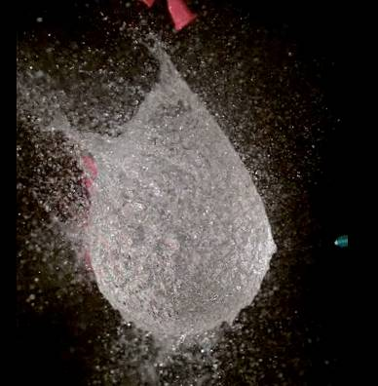
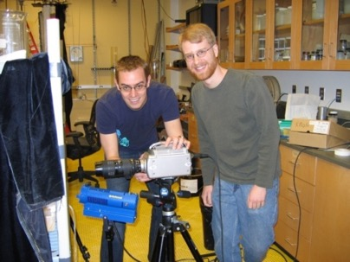

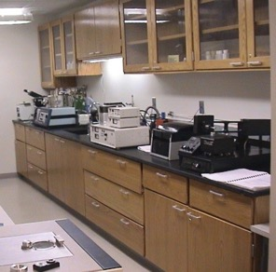

Infrastructure mrfn.org/instruments
MRFN Statistics
20 centers
1144 instruments
262 experts
Yearly Users of MRSEC Facilities (non MRSEC Participants)
  > 1246 Academic
  > 642 Industry
  > 31 National Labs
350 Publications acknowledged MRSEC SF in 2018 (+612 from closing or NCE Centers)
77 MRSEC Technical Staff in SEFs
8 Other Technicians
46 Administrative Staff
31 Education Staff

Slide 8


























Innovation
MRSEC Startup Companies
Since 1985: 158 (82 since 2010) companies in 22 states plus 5 abroad employing ~ 2840 individuals; More than 1500 patents awarded

Slide 9
Activities & Funding in 2017/18
MRFN Workshop
March 9-10, 2018 @ UCSB
Ram Seshadri, Mark Hersam, Ali Yazdani and Nadya Mason
Fourth Year Site Visits
12 Visits from April 9 - June 15, 2018
iSuperSeed2 Competition in July 2019: $7.45M (16/34)
Other Supplements: $0.45M

Slide 10
2019-2020 MRSEC Competition
2019: Eight 2nd Year Site Visits
April 17 – May 29

Slide 11
2019-2020 MRSEC Competition
Preliminary Proposal Due Date:
June 24, 2019
Full Proposal Deadline:
November 26, 2019
Reverse Site Visits
February/March 2020

Slide 12
2019-2020 MRSEC Competition
Anticipated Type of Award:
Yearly Cooperative Agreement
Estimated Number of Awards:
8 to 10 MRSECs; 22 – 24 IRGs
Anticipated Program Total Funding Amount:
$31,500,000
Anticipated Funding Amount per IRG:
$1,300,000 - $1,350,000
Award Duration:
6 Years

Slide 13
2019-2020 MRSEC Competition
There are a few minor differences compared with the previous NSF 16-545 solicitation. These are:
Interdisciplinary Research Groups efforts aligned with the NSF Big Ideas as well as other research areas of DMR interest are suggested as possible IRGs research topics;
Preliminary and Full Proposals: MRSEC participants definitions/roles are clarified and uniform. Changed from senior investigator, senior participants etc. to NSF supported and unsupported Contributors named as Primary and Secondary Participants and Primary Collaborators;
Preliminary Proposals: only bios for those individuals listed in the NSF Proposal Cover Page (up to five) are required; other bios will not be accepted;
Preliminary and Full Proposals: results of prior support can only be reported for individuals, up to five, appearing on the NSF Cover Page.
Proposers should contact the Program Director(s) prior to submission to ascertain if the IRG research is suitable for DMR consideration.

Slide 14
IRGs Suggested Research
Proposals are sought that address fundamental, timely and complex materials problems that are intellectually challenging, important to society, belonging to or broadening the current MRSEC portfolio, and possibly aligned with DMR's participation in the NSF Big Ideas:
https://www.nsf.gov/news/special_reports/big_ideas/.
Notably, DMR plays an important role in: Harnessing the Data Revolution; The Future of Work at the Human-Technology Frontier; Understanding the Rules of Life; The Quantum Leap.
Further, potential research topics broadening the current MRSEC portfolio include (but not limited to):
Supervised and Unsupervised Machine Learning addressing materials science complex problems, and in particular as applied to traditional materials science problems in: Ceramics, Metals, Metallic Alloys and others.

Slide 15
IRGs Suggested Research
Additional strategic research areas of DMR interest include:
Synthetic Materials Biology: in such an effort biologists and system engineers work with materials scientists to identify materials challenges hindering advancements of Synthetic Biology, as well as to generate new Synthetic Biology approaches to materials development i.e., "Materials Biology";
Structural Materials under Extreme Conditions: this effort addresses fundamental challenges in ceramic, metallic, and polymeric materials and their composites for applications under extreme conditions;
Recyclable Plastics and Alternative Materials for Sustainable Development: these efforts could include (i) development of intrinsically recyclable polymers, (ii) better understanding of mechanical properties of recycled plastic products, (iii) strategies to improve the properties of recycled plastics, (iv) materials alternatives for plastics.

Slide 16



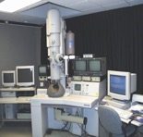












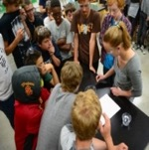







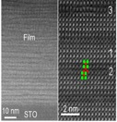


Some Emerging Research Areas of Particular Interest to DMR
Integrated Tool Development for Materials Synthesis & Characterization
Machine Learning
Materials Genome Initiative & Data (“Capta” (computational data)) Science
Materials Sustainable Development
Materials Synthetic Biology
Quantum Materials
Recyclable Plastics and Alternative Materials
Where Materials Begin & Society Benefits

Slide 17
Class of 2014: 12 MRSEC 32 IRGs
CLASS of 2014: Brandeis, Chicago, Colorado, Columbia, Harvard, Minnesota, MIT, Nebraska, NYU, Ohio State, Penn State, Princeton.

Slide 18
Class of 2017: 8 MRSEC 19 IRGs
CLASS of 2017
Cornell, Northwestern, UC Santa Barbara, U Penn, U Texas-Austin, U Washington, U of Illinois, U of Wisconsin.

Slide 19
MRSEC Competition Review
Preliminary proposals will be reviewed by topical panels: IRGs will be reviewed in topical panels. A MRSEC proposal may be reviewed in 3 different panels. Panel advises which IRGs can be considered for a full submission. A full proposal will include a minimum of 2 viable IRGs.
Full proposals will be reviewed by ad-hoc mail review. Full proposals with 2 viable IRGs may be recommended for the Reverse Site Visit Review.
A panel of experts will be in attendance at the Reverse Site Visit; 5-7 RSV Panels (2 proposals/panel) will be held in February/March 2020 at NSF.

Slide 20
2019 MRSEC Directors Meeting
Tuesday October 15, 2019
@ NSF

