Slide 1

Designing Materials to Revolutionize and Engineer Our Future (DMREF)
John Schlueter
Program Manager
National Science Foundation
Alexandria, VA

Slide 2
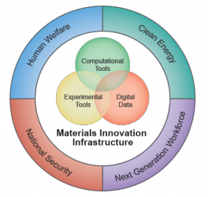
Materials Genome Initiative (MGI)
Established June 2011
To help businesses discover, develop, and deploy new materials twice as fast at a fraction of the cost.

Slide 3
Goals of the MGI
Leading a culture shift in materials research to encourage an integrated team approach.
    Integrating experiment, computation, and theory.
    Making digital data accessible and useful.
    Creating a world-class materials workforce that is trained for careers in academia or industry.
Whitepaper (2011)
Strategic Plan (2014)
5-year Highlights (2016)
www.mgi.gov

Slide 4
Designing Materials to Revolutionize our Future (DMREF)
DMREF is the primary program by which NSF participates in the Materials Genome Initiative.
June 2011: MGI announced
2012: DMREF began as a Dear Colleague Letter
  3 Divisions: MPS-DMR, ENG-CMMI, ENG-CBET
2013: Expanded to include 10 Divisions
  3 Directorates: MPS, ENG, CISE
2015: DMREF became official program
2017: DMREF moves to biennial competition
2019: DMREF proposals due in January

Slide 5


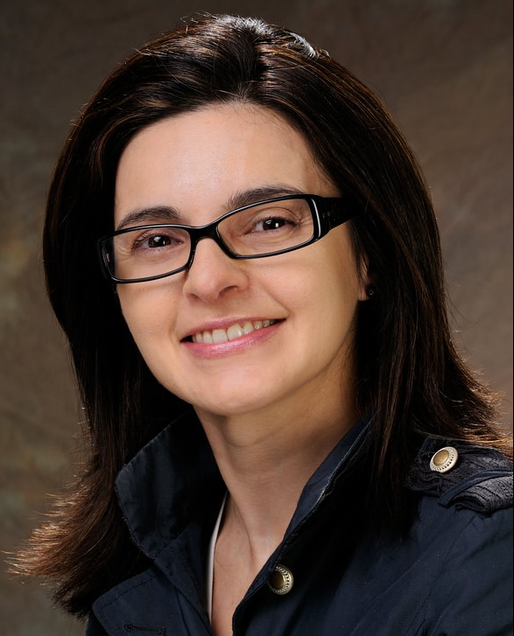

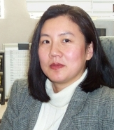


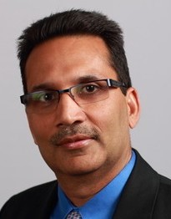


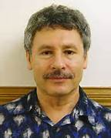
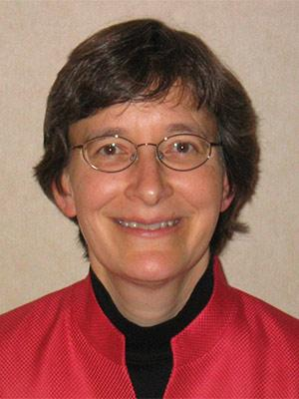
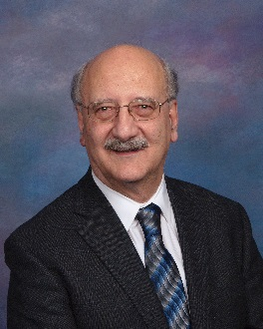
DMREF Management Team
CISE
MPS
ENG
Almadena
Chtchelkanova
CCF
Rajiv Ramnath
OAC
Eva
Campo
DMR
John Schlueter
DMR
Suk-Wah Tam-Chang
CHE
Alexis Lewis
CMMI
Bob McCabe CBET
Sylvia Spengler
IIS
Vipin Chaudhary
OAC
Pedro Embid
DMS
Marian Bocea
DMS
Victor Roytburd
DMS
Susan
Muller
CBET
Dimitris Pavlidis ECCS

Slide 6
DMREF Funding
FY12: 14 awards, $13.6 M
  3 yr: 9 (64%)
FY13: 19 awards, $22.2 M
  3 yr: 13 (68%)
FY14: 31 awards, $36.3 M
  3 yr: 24 (77%)
FY15: 26 awards, $33.9 M
  3 yr: 15 (58%)
FY16: 24 awards, $30.3 M
  3 yr: 9 (38%)
FY17: 26 awards, $36.0 M
  3 yr: 9 (35%)
*‘Other’ funding from directorates is from GOALI & OMA.
Cumulative
140 Projects, $172 M total investment, 532 PIs
FY17
80% of projects received co-funding.
OAC co-funded 8 projects due to significant data component.

Slide 7
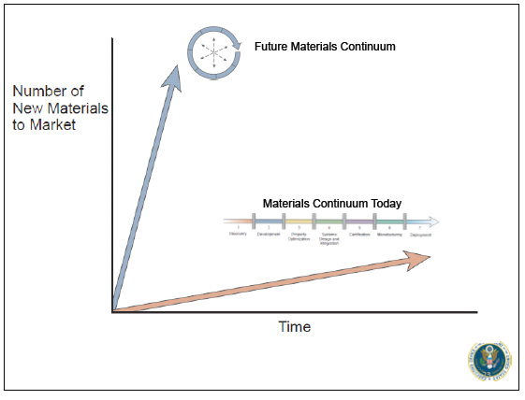
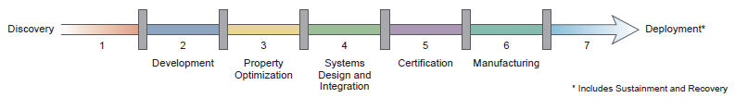
Accelerating Advancement along the Materials Development Continuum
Development
System Design
Manufacturing
Discovery
Optimization
Certification
Deployment
Contemporary path to deployment.
NSF
Applied funding
Industrial Partner
I-corps
SBIR
Mathematics → Chemistry → Materials → Engineering
To avoid ‘Valley of Death’, technologies often require seamless partnerships.

Slide 8


















Federal MGI Partners
Coordination of MGI-related efforts is critical to success.

Slide 9
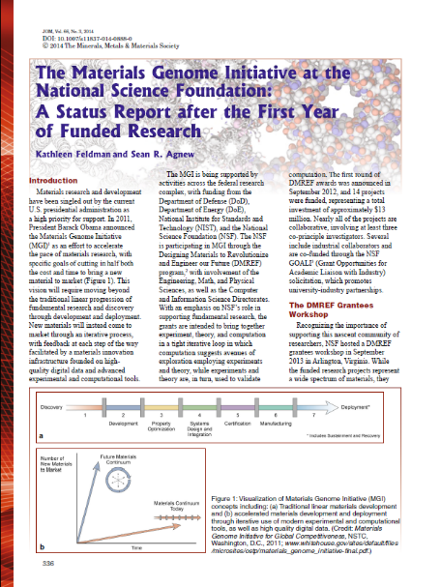
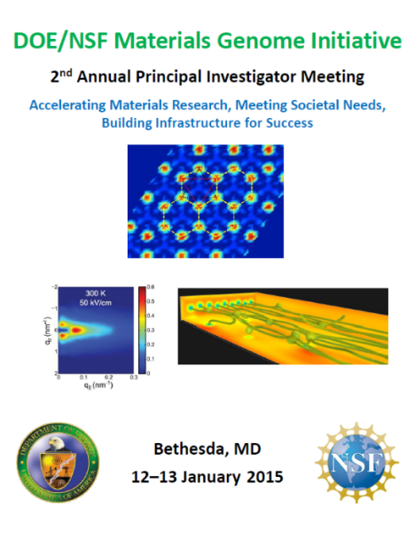
MGI PI Meetings
Sept. 8-9, 2013
NSF
45 Participants
Jan. 12-13, 2015
NSF & DOE
160 Participants
January 11-12, 2016
NSF, DOE, NIST
192 Participants
March 26-27, 2018
NSF, DOE, NIST, AFRL
270 Participants
In
Preparation
JOM 2014, 66(3), 336
https://app.certain.com/profile/form/index.cfm?PKformID=0x2753823abcd
or contact Jschluet@nsf.gov

Slide 10
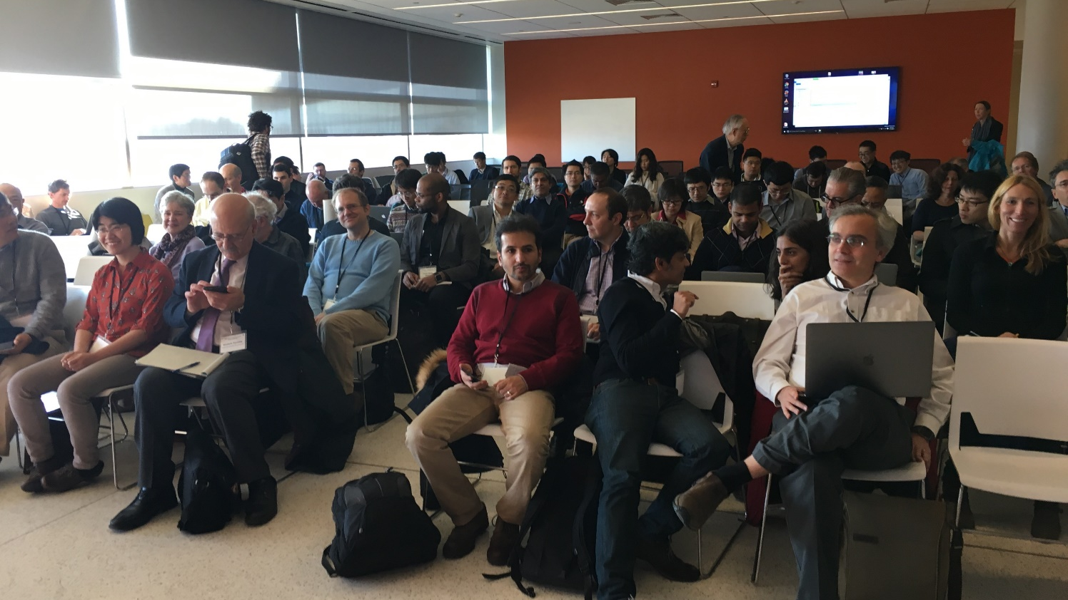
Supplements: 2D Materials & Devices
Penn State: November 13-15, 2017
Encouraged partnerships between DMREF and EFRI* or MIPS
Harnessing data related to 2D Materials and Devices
20 Supplements Awarded: $2.5 M
See Eva Campo for further details.
*Emerging Frontiers in Research and Innovation

Slide 11
Supplements: MGI PI Meeting
U. Maryland: March 26-27, 2018
Encouraged partnerships between DMREF federal MGI partners
Objectives:
    Advancing along Materials Development Continuum
    Harnessing the power of data
25 Supplements Awarded: $2.5 M
    DOE Energy Materials Network (6)
    National Institute of Standards and Technology (6)
    Air Force Research Laboratory (5)
    DOE Computational Materials Centers (4)
    NSF Grant Opportunities for Academic Liaison with Industry (3)
    National Aeronautics and Space Administration (1)

Slide 12
2019 DMREF Competition
1) The submission window is January 14-28, 2019.
2) Four strategic areas have been prioritized for this competition.
Synthetic Materials Biology
Structural Materials under Extreme Conditions
Recyclable Plastics and Alternative Materials for Sustainable Development
Robotic Materials
3) All awards will be four years in duration.
4) Awards are expected to range from $1,000,000 to $1,750,000.
5) Google credits, ranging from $8,000 to $20,000 will be made available to PIs.
6) Emphasis has been placed on a comprehensive Data Management Plan.

Slide 13
DMREF Review Criteria
Accelerating progress along Materials Development Continuum
    How effectively does the proposed work help accelerate materials discovery, understanding, and/or development by building the fundamental knowledge base needed to progress toward designing and making materials with specific, desired functions or properties?
Effectiveness of iterative feedback loop.
How effectively does the proposed research use collaborative processes with iterative feedback among tasks? The materials synthesis / growth / processing techniques, characterization / testing methodology, theory / mathematics, data science, and computation / simulation aspects of the project must all strongly interact with each other to promote significant advances in each of these components and advance materials design.
Training in an MGI mindset.
How effectively does the proposed work provide training for the next generation of scientists and engineers, educated in a multidisciplinary, integrated experimental and computational approach to materials research? Has adequate data-related training been provided for students and post-docs, as needed?
Making digital outputs useful to community.
How effectively does the proposed work and corresponding data management plan provide open access to outputs, including data, software, codes, samples, and publications?

