Slide 1
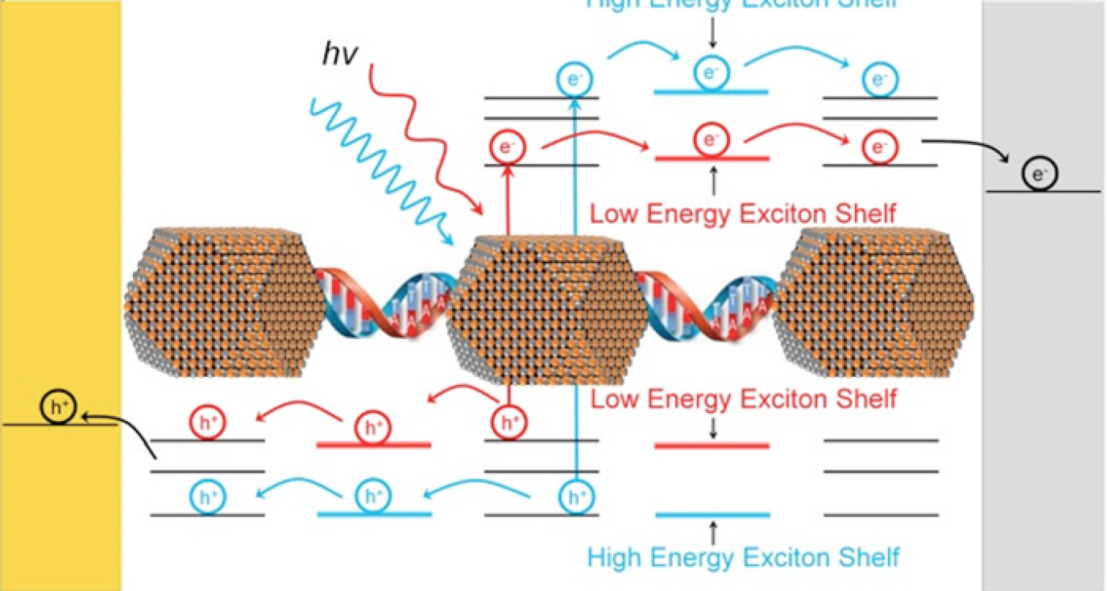
• Quantum Dot / DNA Necklaces
Researchers at the Soft Materials Research Center of the University of Colorado have made hybrid bio-semiconductor nano-necklaces consisting of strings of nanometer size quantum dots (QDs) tethered by nano-length DNA chains. When the necklaces are connected between electrodes and illuminated, the alignment of the energetic states of the QDs and DNA enables charge conduction, making it is possible to transport charge carriers photogenerated in the QDs through the exciton shelves in the DNA.

