Slide 1
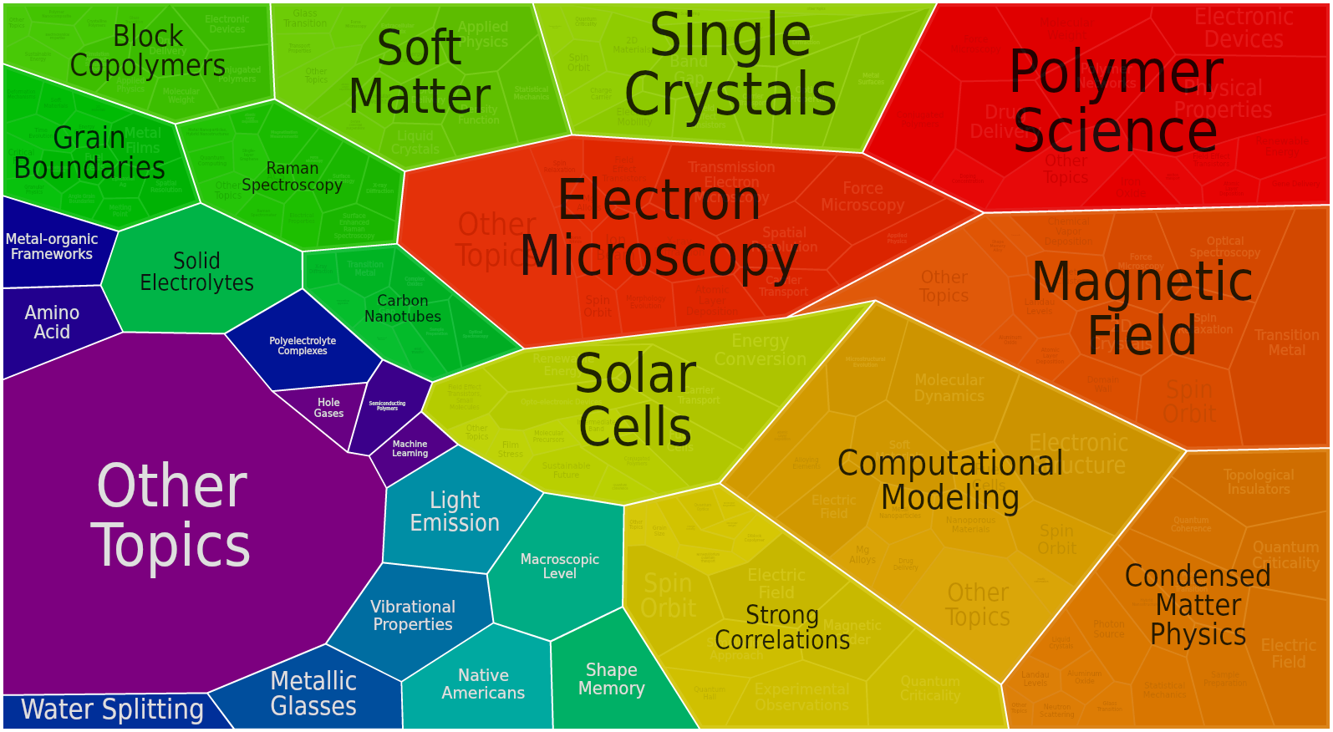
Division of Material Research (DMR)
Mary Galvin, Division Director
From Project Summary of FY 13 Awards

Slide 2
DMR
Individual Investigator Awards Programs – CMP, CMMT, SSMC, BMAT, POL, CER, MMN, EPM
Centers
  Materials Research Science & Eng. Centers, Partnerships for Research & Education in Materials
  Nano Centers & NNIN
  Science & Technology Centers
Facilities
  National High Magnetic Field Laboratory
  Cornell High Energy Synchrotron Source
  Center for High Resolution Neutron Scattering - NIST
PI Distribution by Academic Department

Slide 3
DMR Budget
FY13: $291 M
FY12: $295M
56.3% to 55.6% -Individual Investigators
18.9% to 20.8% - Facilities
19.8 % to 19.8 % - Centers MRSEC, Nano, STC
Going forward budget decreases may not be taken exclusively from new awards.
These charts do not include Foundation-wide programs such as IGERT, MRI and GRF.
These charts do not include Foundation-wide programs such as IGERT, MRI and GRF.

Slide 4
DMR Budget – Constant Dollars

Slide 5
Proposal Pressure
Between 2000 to 2013
64 % increase in proposals
17% increase in constant dollars

Slide 6
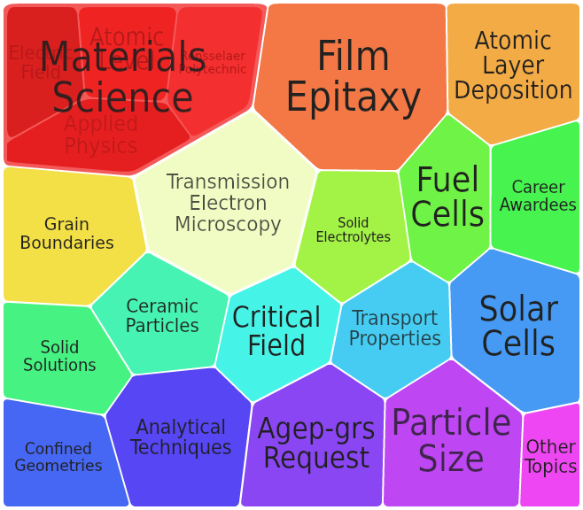
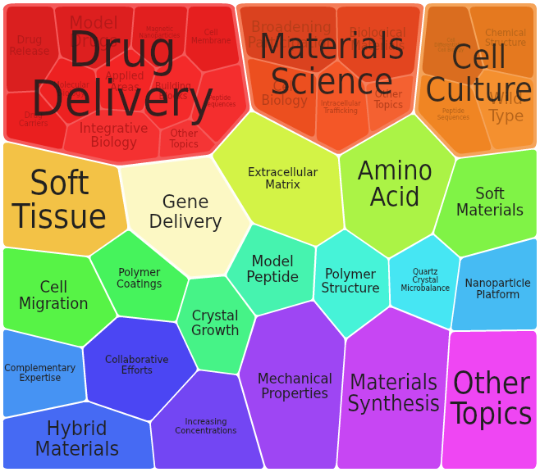
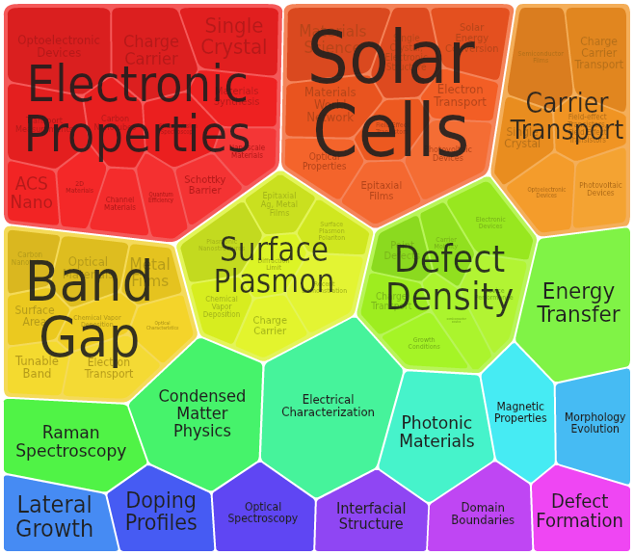
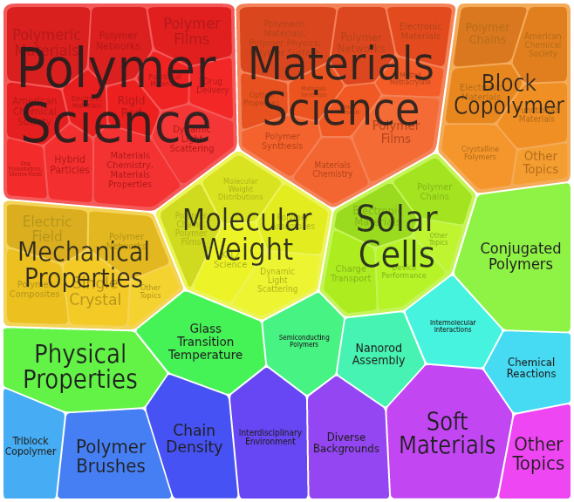
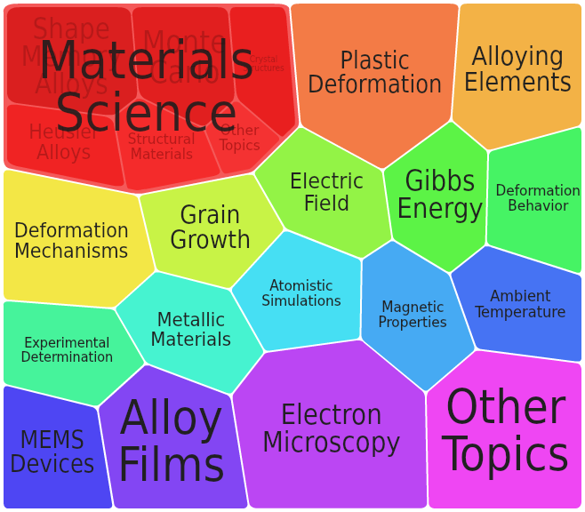
Material
BMAT
Joseph Akarra
Aleksandr L Simonian
CER
Lynnette Madsen
EPM
Charles Ying
Haiyan Wang
POL
Andrew Lovinger
MMN
Gary Shiflet

Slide 7
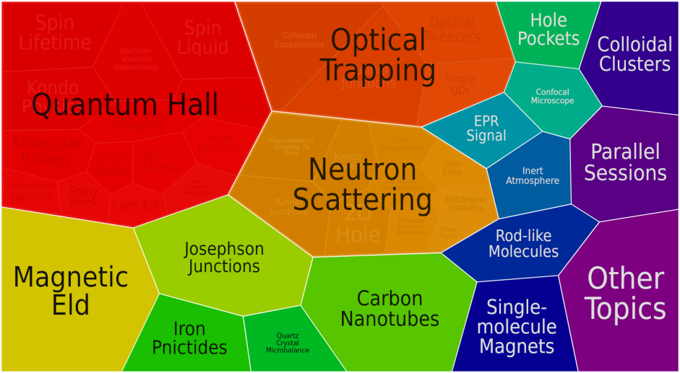
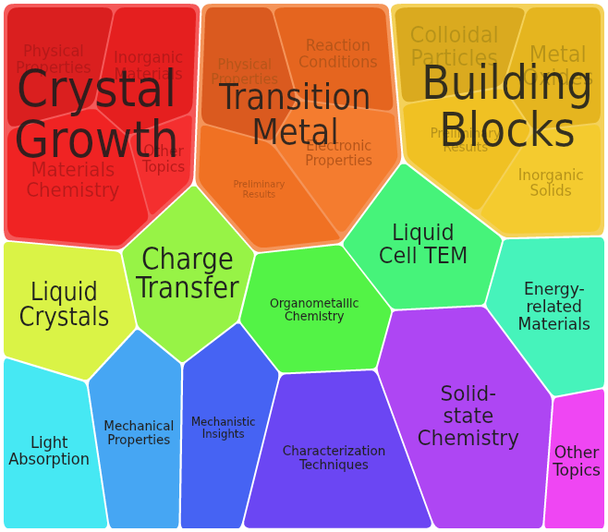
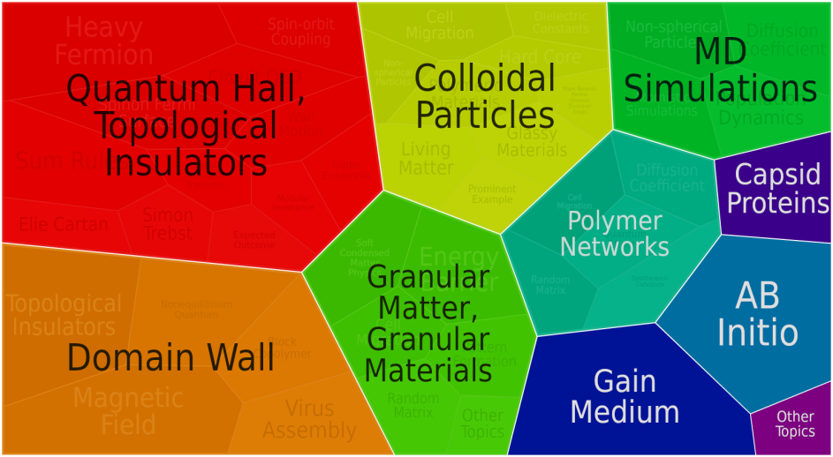
Discipline
CMP
Tomasz A Durakiewicz
Paul Sokol
SSMC
Michael Scott
CMMT
Daryl Hess
Serdar Ogut
Andrey Dobrynin

Slide 8
Funding Rate by Program

Slide 9
Program Changes
CDMR is now under the CMMT umbrella
International:
  IMI ended in FY13
  MWN was suspended in FY14
  Evaluating strategy for FY15 and beyond
MRSECs base funding to $56M –awards larger & MRSECs > 2 IRGs the number of centers may decrease
Liquid He – looking at ways to assist the community given the scarcity and increasing He costs
FY15 plan mid-scale facility program

Slide 10
International Awards in DMR
2005-2013
One third of DMR portfolio has an international component
We are reviewing our international strategy
Watch for Dear Colleague Letter & survey

Slide 11
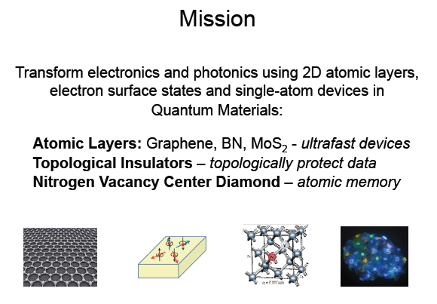
New STC: CIQM
Center for Integrated Quantum Materials
Harvard, MIT and Howard
PI: Robert Westervelt

Slide 12
Nation’s Multidisciplinary User Facilities
Stewardship: Provides high cost and unique experimental capabilities to the DMR community.
  Cornell High Energy Synchrotron Source
  National High Magnetic Field Laboratory
Partnership: Partners with others to provide resources to the DMR community.
  With NIST: The Center For High Resolution Neutron Scattering (CHRNS) at the NIST Center for Neutron Research
  With DOE: The Intermediate Energy X-Ray (IEX) beamline 29-ID currently under construction at the Advanced Photon Source.
  With NSF/Chem: ChemMatCARS Beamline at the Advanced Photon Source
  With NSF/ENG: National Nanotechnology Infrastructure Network (NNIN)
POs Thomas Rieker, Tess Guebre, Sean Jones

Slide 13
DMR is Seeking Advice from the
MPS-AC on Facilities and Instrumentation
Sub-Committee Co-chairs:
Cherry Murray, Harvard and George Crabtree, Argonne
Report: approved August2014
Charge to the Panel:
Advice on how to invest DMR’s facilities budget to accelerate materials science and condensed matter physics as rapidly as possible
  Do not restrict recommendations to large facilities – balance of large, mid-scale or center size facilities should be included.
  Not individual instrumentation acquisition, which is handled through Major Research Instrumentation program
  In determining critical need consider whether needs are met by what is currently available through other sources and agencies, nationally and internationally
http://www.nsf.gov/mps/advisory/mpsac_other_reports/materials_instrumentation-final_from_subcommittee.pdf

Slide 14
MPSAC Report -Closing the Loop: Materials Instrumentation
From talk by Charles Ahn – needs for
Hard Materials
US Nobel prizes in hard materials –
Other than theory they come from Bell or IBM labs

Slide 15

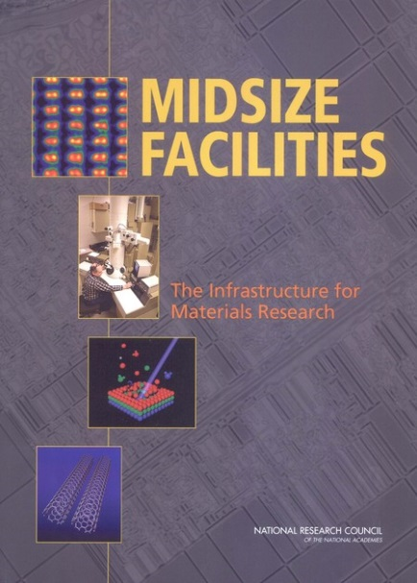
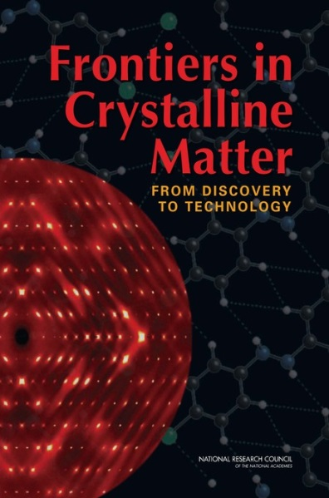
DMR Midscale:
Materials Innovation Platforms
MidSize Facilities (2006), COV (2011), and Materials 2022 (2012) recommended we consider platforms to enhance Materials-related infrastructure in the U.S.
FY15 Request (+$8 million)
Mid-scale user facilities focused on a science topic, not an instrumentation type, and are likely to combine synthesis, characterization, theory and computation in line with MGI/DMREF
Include instrument development and cross-disciplinary training of users and students
Support for technical staff
Specifics will be informed by the MPSAC report and future workshops.

Slide 16
NSF Initiatives

Slide 17
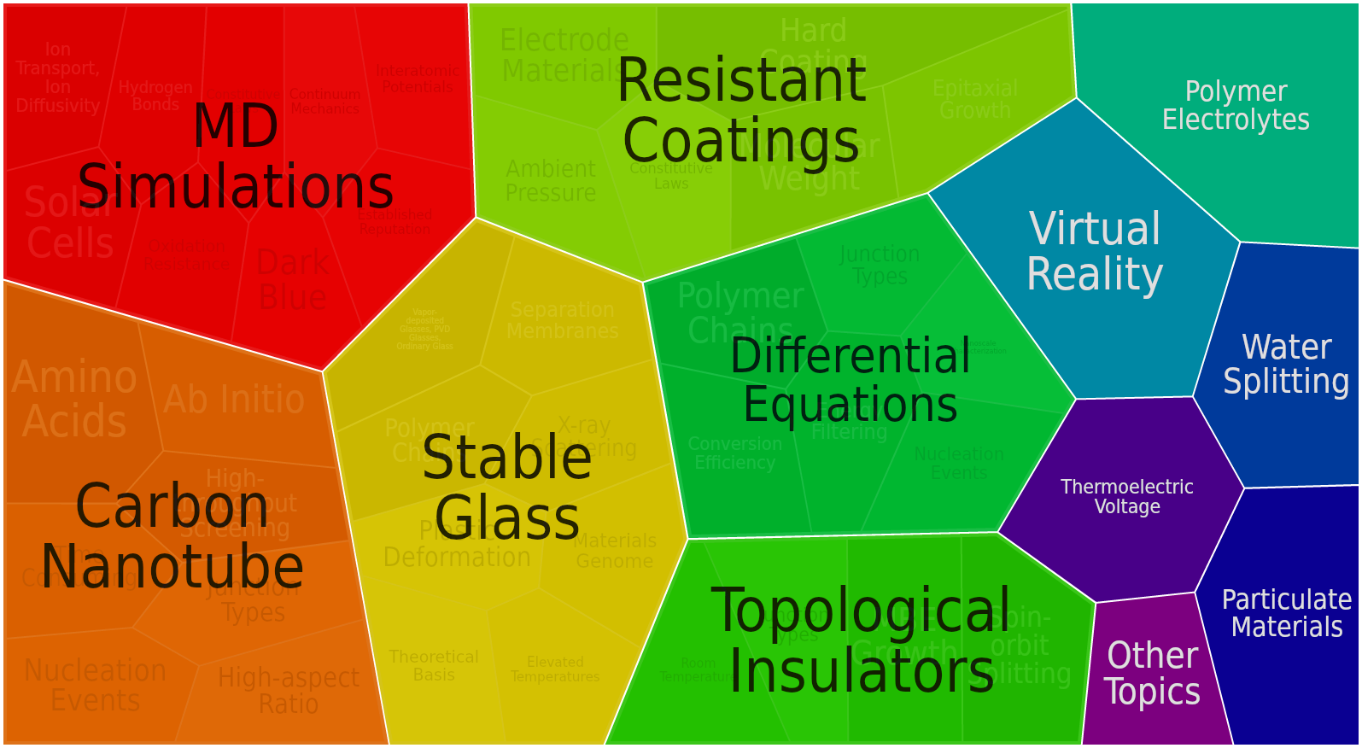
Designing Materials to Revolutionize and Engineer the Future (DMREF)
In Response to Materials Genome Initiative
Build the fundamental knowledge base needed to progress towards designing and making a material with a specific and desired function or property from first principles
Accelerate materials discovery and development.
Experiments must drive theory/simulation and theory/simulation must drive experiments: through a Collaborative and Iterative process.
6 Divisions: DMR, CHE, Math,
2 ENG,and Computer Science
John Schlueter – Program Officer
FY12: $13.6M
FY13: $22.2M
FY14: $30.0M
FY15R: $22 M

Slide 18
DMREF PROPOSALS
Must include - Materials synthesis/growth/processing, materials characterization/testing, and theory/data/computation/simulation components of the research.
Must go beyond simple collaborations. – iterative feedback loop between all components.
Want to see advances in all components of the project.
Address open access to algorithms and data.
Accelerate materials discovery (DMR) and development
Most successful go beyond:
  Simply including theoretical and computational research.
  Simply comparing theory/simulation and experiment.
  Collaborations already funded in DMR and NSF.
Awards have been to research groups. (Award size has gone to $1.45M over 4 years)
New solicitation for FY15 – proposals due Jan 5 – Jan 29

Slide 19
Sustainable Chemistry, Engineering and Materials (SusChEM)
SusChEM proposals are expected to take a systems-based approach to understanding, predicting and facilitating advances towards global sustainability.
Fundamental research topics
Replacement of rare, expensive, and/or toxic chemicals/materials with earth-abundant, inexpensive, and benign chemicals/materials
Recycling of chemicals/materials that cannot be replaced
Development of non-petroleum-based sources of important raw materials
Chemicals/materials for food and/or water sustainability;
Elimination of waste products and enhancement in efficiencies of chemical reactions and processes
Discovery of new separation science that will facilitate recycling and production of valuable chemicals/materials
Development and characterization of low-cost, sustainable and scalable-manufactured materials with improved properties.
3 Directorates:
MPS - DMR, CHE
ENG – CBET, CMMI
GEO - EAR
Andy Lovinger,
Program Officer
FY13: $24M
FY14: $23M
FY15R: $23M

Slide 20
Research at the Interface of Biological,
Mathematical, & Physical Sciences (BioMaPS)
BRAIN
Adaptive network models
Biological design strategy for better composite materials
Computational, Mathematical and Statistical modeling
DMR: $2.9M in FY 2014

Slide 21

I-Corps: Testing the Commercial Validity of NSF-funded Research
Some NSF Programs with Innovation Emphasis
Team Based: Entrepreneurial Lead, PI and Mentor
$50K to “Get out of lab”
3-Month Curriculum
Goal – get a business plan
Program Outcomes
  Functioning network of Mentors/Advisors
  Scientist and Engineers trained as Entrepreneurs
  Increased impact of NSF-funded research
Credit: © 2011 JupiterImages Corp.
GOALI: Increasing Collaboration between Academia and Industry
Grant Opportunities for Academic Liaison with Industry (GOALI) NSF 12-513
Promotes university-industry partnerships
Excellent educational benefits for students and postdoctoral fellows
Funds available support an eclectic mix of industry-university linkages, incl. fellowship/traineeships
Requires Intellectual Property Agreement

Slide 22


Cyber Infrastructure Framework for 21st Century Science and Engineering (CIF21)
Cyberinfrastructure to transform research, innovation, and education
Major components
  Computational and Data-enabled Science
  (CDS&E)
  Core Technologies, Tools, Algorithms
  Big Data Projects
  Workforce Development
  Partnerships: internal/external
  Software Institutes
DMR: $3.6M in FY 2014

Slide 23
Software Infrastructure for Sustained Innovation (SI)²
Expected to generate and nurture the interdisciplinary processes required to support the entire software lifecycle
Envisions partnerships among academia, government labs, and industry, including international entities
Programs:
Scientific Software Elements (SSE) – small groups that create and deploy robust software elements
Scientific Software Integration (SSI) – larger, interdisciplinary teams to develop and apply common software infrastructure
SSE and SSI (NSF 13-525) – DMR focus on DMREF and SusChEM, deadline First Monday in Feb each year
(3) Scientific Software Innovation Institutes (S2I2) – establish long-term hubs of excellence in software infrastructure
NSF 13-511 – DMR focus on Materials Genome Initiative

Slide 24
Thank You.

