Slide 1
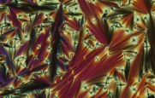

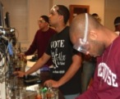
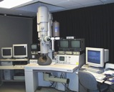
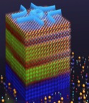




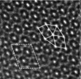
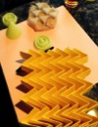


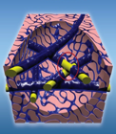

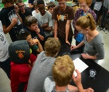

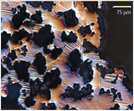
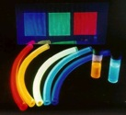





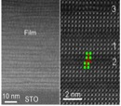



NSF Division of Materials Research
MRSEC Director’s Meeting, October 13, 2015
Linda Sapochak, Acting Division Director
Dan Finotello

Slide 2
DMR: 3 years in review
DMR funding resulted in …..New Forms of Matter….New Materials…New Materials Understanding…New Tools to Study Materials………. And a broadened portfolio.
New programs were created.
Designing Materials to Revolutionize and Engineer our Future (DMREF)
Computational & Data-Driven Materials Research (CDMR)
Major NSF-wide initiatives had a big influence on DMR investments and future plans.
Materials Genome Initiative (MGI)
Cyber-infrastructure for the 21st Century (CIF21)
Science, Engineering and Education for Sustainability (SEES)
Government sequestration and shutdown affected how we did business. iTrak dates affected MRSEC
Programs were ended.
Computational & Data-Driven Materials Research (CDMR)
Materials World Network (MWN)
International Materials Institutes (IMI)

Slide 3
National Science Foundation
France Córdova
National Science Board
Director and
Deputy Director
Office of Diversity & Inclusion
Office of the General Counsel
Office of the
Inspector General
~$7.1 B/ FY14
Office of Integrative Activities
Office of International Science & Engineering
Biological
Sciences
Computer &
Information
Sci &Eng
Engineering
Geosciences
Office of Legislative & Public Affairs
$721M
$893M
$833M
$1.32B
Mathematical
& Physical
Sciences
Social,
Behavioral,
& Economic
Sciences
Education
& Human
Resources
Budget, Finance, & Award Management
Information
& Resource
Management
$257M
$1.27B
Notes:
Numbers acquired from EIS BEP module (NSF Official Data)

Slide 4
Mathematical and Physical Sciences
MPS
Assistant Director
Fleming Crim
Office of Multidisciplinary Activities
$1.27B
(FY 14 budget)
$35 M
Astronomical Sciences
Director
James S. Ulvestad
Chemistry
Director (Acting)
Carol Bessel
Materials Research
Director (Acting)
Linda S. Sapochak
$238 M $235 M $298 M
Mathematical Sciences
Director
Michael Vogelius
Physics
Director
C. Denise Caldwell
$267 M
$225 M
Notes:
Updated

Slide 5





DMR Staffing Changes 2011-2014
2011-2012
Program Directors: 16 (16.8 FTEs)
Admin. Unit: 5 staff 2 students
Janice Hicks Deputy Division Director
Velma Lawson
Program
Support Manager
Ian Robertson
Division Director
Neila Odom-Jefferson Operations Specialist
Program Directors: 15.5 (16.8 FTEs)
Admin. Unit: 5 staff 2 students
2013-2014
Program Directors: 14 (13.8 FTEs)
Admin. Unit: 5 staff 2 students
Janice Hicks Deputy Division Director
Velma Lawson
Program
Support Manager
Mary Galvin
Division Director
Neila Odom-Jefferson Operations Specialist
Program Directors: 15 (13.8 FTEs)
Admin. Unit: 4 staff 0 students
Notes:
Lost Carmen in 2013
Mary become DD in 2013 (# PDs went down and 1 permanent) Dave Brant retired
Linda Acting DDD in CHE in Jan 2013- July 2013(6months) and Jan 2014-July 2014

Slide 6
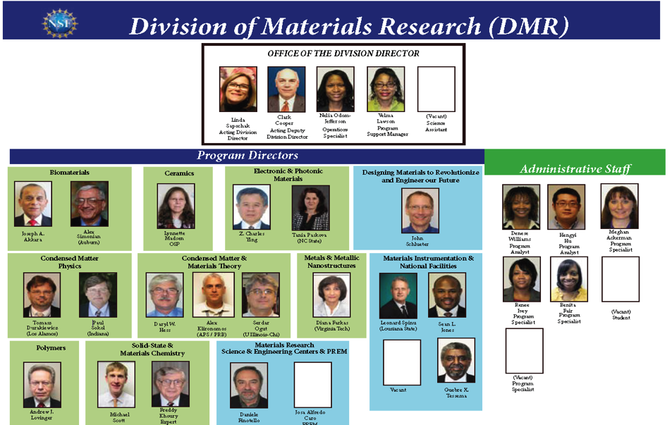

Slide 7




2011-2014 – How Budgetary Factors affected NSF Review Panels
March 2013, Sequestration
October 1-16, 2013 Federal Government shutdown
FY13 budget delay until June 2013
March 2013, Sequestration
October 1-16, 2013 Federal Government shutdown
FY13 budget delay until June 2013
$
30% cut
Use of virtual panels increased from 2013 to present.

Slide 8
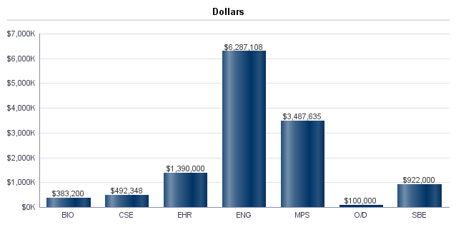
FY 14 Co-Funding Dollars to other Directorates from DMR
MGI
INSPIRE
Optics & Photonics
Adv. Manufacturing
Nano-Signature Initiatives
Clean Energy
SEES
CIF21
BioMAPs
I-Corps
Program Directors work across NSF to ensure best review of interdisciplinary proposals
DMR engaged in many NSF-wide initiatives in 2011-2014.

Slide 9

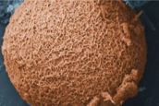

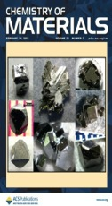
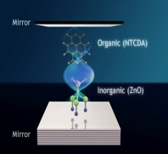






DMR Mission
To make new discoveries about the behavior of matter and materials.
To create new materials and new knowledge about materials phenomena.
To address fundamental materials questions that often transcend traditional scientific and engineering disciplines and may lead to new technologies.
To prepare the next generation of materials researchers.
To develop and support the instruments and facilities that are crucial to advance the field.
To share the excitement and significance of materials science with the public at large.

Slide 10
PI Departmental Affiliations
But diverse as they are, materials scientists look at materials from a unified point of view: they look for connections between the underlying structure of a material, its properties, how processing changes it, and what the material can do - its performance. (From Strange Matter)

Slide 11
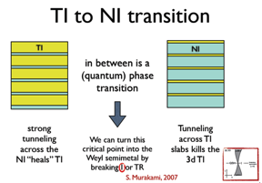


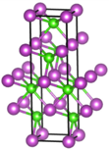
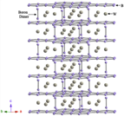
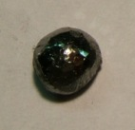

DMR Research Investments are Broad and Growing
Research advances and new materials which did not exist 4 years ago………..
New States of Matter
New Materials
Single layer boron & borospherene
SSMC/L-C. Wang (Brown U.)
Topological Insulators (CMMT, CMP, MRSEC)
Weyl Semi-metals
CMMT
ReB₂
Ultra-incompressible,
Superhard Borides
Skyrmions
CMP / K. Liu (UC-Davis)
Hybrid exciton polaritons
EPM/ V.M. Menon (CUNY-Queens) S.R. Forrest (U. Michigan)
SSMC/L-C. Kaner & Tolbert (UCLA)
Notes:
Cuprates - they show that charge order can be found BOTH in hole-doped as well as in electron-doped cuprates, which creates a strong link between the two groups, formerly suspected to be completely different since their normal state properties are different.
Skyrmions - we all want a novel quantum supercomputer or a new type of memory. But how to build one? Most elements we have do not scale, or live only at ultra low temperatures. This is the first example of something scalable and alive at high temperatures. Each individual skyrmion in a lattice can be used as a carrier of information bit, so perhaps in a decade we will use those in our cellphones?
Weyl semi metals CMMT
CER and sustainability
Pol water filtration
More connection between computation/modeling/data and experiment

Slide 12
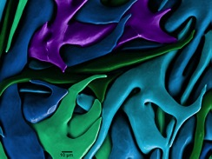
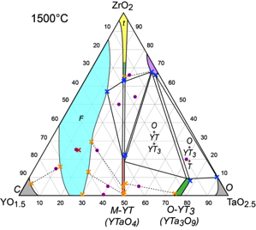
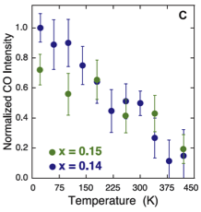
New Materials Understanding
Crystal of calcium carbonate made by the sea urchin, at the forming end of one of its teeth
Reveals self-healing mechanism.
BMAT/Gilbert; U. Wis. Madison
TaO_{2.5}-YO_{1.5}-ZrO₂ phase diagram
Reveals large compositional space over which CER coatings with improved combinations of toughness and chemical resistance can be synthesized
CER/C.G. Levi (UCSB)
Superconductivity in Cuprates
Charge order can be found BOTH in hole-doped as well as in electron-doped cuprates
CMP/R.L. Greene (U. Maryland)
Notes:
As the teeth wear away, they are replaced by a self-healing mechanism that materials scientists seek to understand and harness. The work shows how biomaterials researchers are mimicing living to enerate functional materials with unusual and useful properties.
Cuprates - they show that charge order can be found BOTH in hole-doped as well as in electron-doped cuprates, which creates a strong link between the two groups, formerly suspected to be completely different since their normal state properties are different.

Slide 13


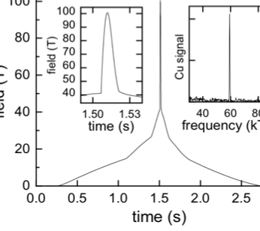


Developing New Capabilities
to Study Materials
NHMFL supports users and magnet development.
May 2012 NHMFL broke the megagauss barrier by reaching 100.75 teslas (2.5 million times the earth’s magnetic, field, top Fig.).
Major achievement in nano-composite materials engineering and magnet development to open new scientific frontiers in materials research.
.
Breaking the Megagauss Barrier*
for Non-Destructive Magnetic Fields
The project was jointly funded by the National Science Foundation and Department of Energy
Notes:
Top Figure: The time structure of the 100 tesla field Left Inset, a close-up of the magnetic field profile in time. Right inset, is a Fourier Transform of the deHaas-van Alphen magneto quantum oscillations of polycrystalline copper at 1.5 K as a function of inverse magnetic field showing the distinct peak which is used for an accurate in-situ calibration of the magnetic field. The Measured magnetic field intensity is 100.75 +- 0.1 tesla.
Bottom Figure: The Fermi surface of the most heavily-studied high-temperature superconductor, YBaCuO, once superconductivity is suppressed by the intense magnetic field.

Slide 14
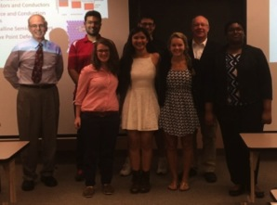


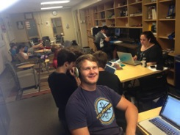

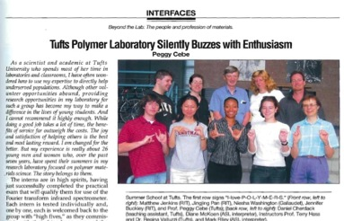
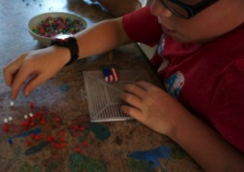
Preparing the Next Generation of Materials Researchers
Columbus School for Girls Summer Internship Program
Leonard J. Brillson (The Ohio State University), DMR-1305193
Boulder School for Condensed Matter and Materials Physics
L. Radzihovsky (with M. P. A. Fisher, S. M. Girvin, C. Marchetti)
University of Colorado,
DMR-0969083
High School Teachers and Students Doing Research on Glass
Steven Feller, Mario Affatigato, Ugur Akgun, Coe College, DMR 1407404
65 graduate students and postdocs
19 international lecturers
2 public public lectures
student poster sessions and seminars
http://boulder.research.yale.edu/Boulder-2012
Encouraging Scientific Engagement in Children with Dyslexia
Corinne E. Packard, Colorado School of Mines, DMR 1352499
The pioneering REU Site for deaf students funded by DMR/POL for many years led to the receipt by Professor Peggy Cebe (Tufts U.) of the 2011 Presidential Award for Excellence in Mentoring.

Slide 15
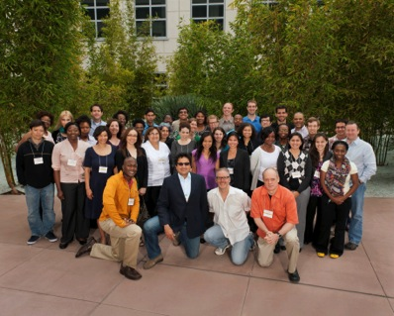
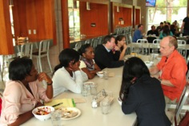
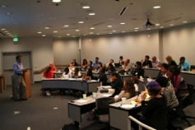
Future Faculty Workshop at UCSB
Timothy M. Swager (Massachusetts Institute of Technology) DMR-1005810 and DMR-1242334
Future Faculty Workshop-focused on the mentoring of graduate students and postdoctoral researchers from disadvantaged backgrounds who aspire to become professors.
5th consecutive year for the workshop
Held on the west coast with the support of the Materials Research Laboratory (MRL), a DMR supported MRSEC, at the University of California Santa Barbara.
The financial support was provided by DMR-1242334, the MRL, and Dow Chemical.
6th workshop held at the Georgia Institute of Technology in Summer of 2013.
Group Photo of the 2012 Future Faculty Workshop at UCSB
Mentors led small group and collective discussions on how to become successful academics.

Slide 16
Funding Levels for Division of Materials Research 2005-2014
Constant FY 2005 dollars excludes ARRA funds

Slide 17
DMR Budget
FY12: $295 M
FY14: $295.7 M
3.3%
46.7%
19%
FY13: $290.8 M
20%
FY15 $306.99
FY16 R $315.8 (2.86%)
These charts do not include Foundation-wide programs such as IGERT, MRI and GRF.
These charts do not include Foundation-wide programs such as IGERT, MRI and GRF.

Slide 18
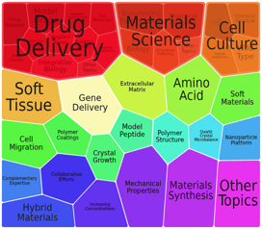
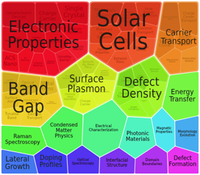
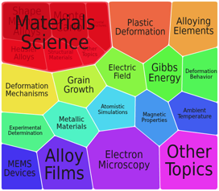




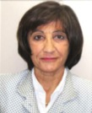
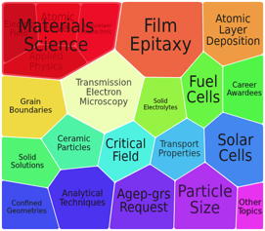
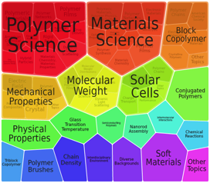


Material-Type Core Programs
Biomaterials (BMAT)
Electronic & Photonic Materials (EPM)
Metal & Metallic Nanostructures (MMN)
Ceramics (CER)
Polymers (POL)

Slide 19
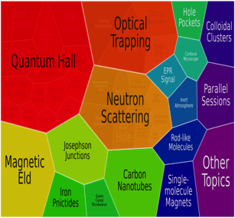
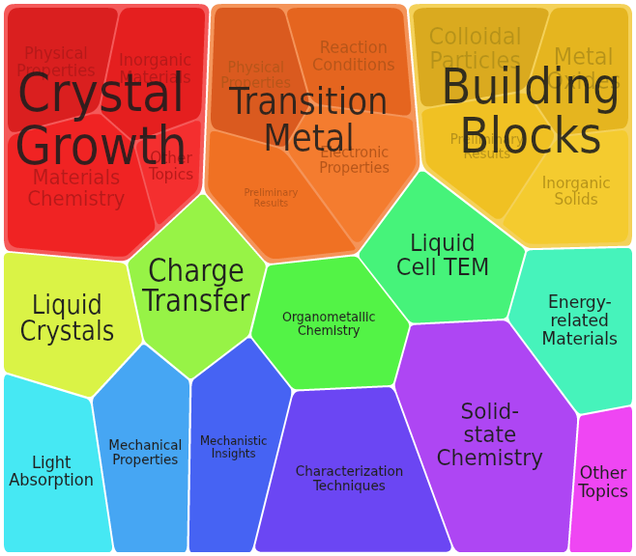
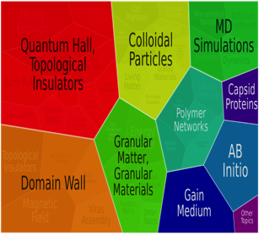




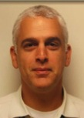

Disciplinary Core Programs
Condensed Matter Physics (CMP)
Solid State & Materials Chemistry (SSMC)
Condensed Matter & Materials Theory (CMMT)

Slide 20
DMR Budget by CORE program
2009 Stimulus Funds
Sequestration & Gov. shutdown
Budget (millions)
Fiscal Year
Notes:
Updated

Slide 21
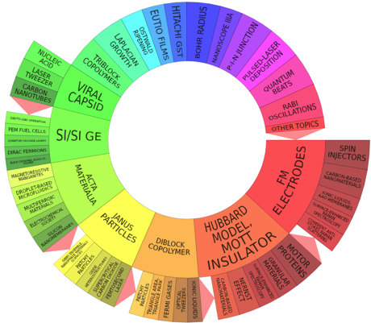
Materials Research Science & Engineering Centers (MRSECs)
1972 NSF established DMR with MRLs
MRSECs must have 2 or more Interdisciplinary Research Groups (IRGs)
Education and REU
Diversity plans
Shared experimental facilities
Competition every 3 years – 6 year awards
Re-competition model and Seed program provide a mechanism for a reinvention and adaptation to address emerging areas (flexibility)
~20% DMR budget

Slide 22

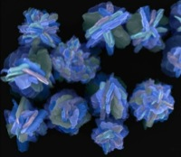

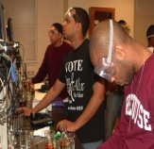

-PREM-
The Partnership for Research and Education in Materials Program
… to address the pipeline of under-represented minority materials scientists…
DMR seeks to broaden participation in materials research and education by stimulating the development of long-term, collaborative partnerships between minority serving institutions and DMR-supported groups, centers, institutes, and facilities. MRSEC major partner!
PREM Competition in 2015

Slide 23
National Facilities & Instrumentation Program
Stewardship: National Facilities program provides high cost and unique experimental capabilities to the DMR community:
  Cornell High Energy Synchrotron Source (CHESS) (current award ends 03/31/2019)
  National High Magnetic Field Laboratory (NHMFL) (current award ends 12/31/2018).
Partnership: National Facilities program partners:
  NIST: The Center For High Resolution Neutron Scattering (CHRNS) at the NIST Center for Neutron Research
  DOE: The Intermediate Energy X-Ray (IEX) beamline 29-ID currently under construction at the Advanced Photon Source.
  NSF/Chem: ChemMatCARS Beamline at the Advanced Photon Source
  NSF/ENG: National Nanotechnology Infrastructure Network (NNIN)
(Tom Rieker & Chuck Bouldin left NSF in 2015)

Slide 24
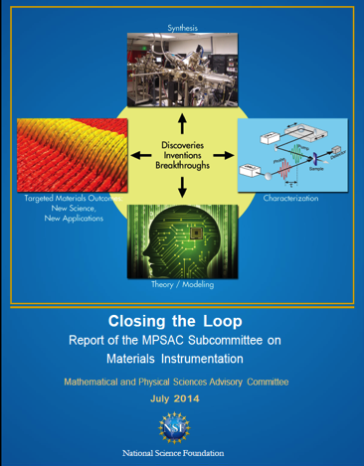
Facilities and Instrumentation Studies – BIG impact on DMR Priorities
Developing a vision for the infrastructure and facility needs of the materials community:
Report of NSF Materials 2022
(A Subcommittee of the Mathematical and Physical Sciences Advisory Committee)
July 2012
Matthew Tirrell, co-Chair
Roger Falcone, co-Chair
With flat budgets, DMR’s investments in facilities should be for “unique capabilities”.
Need national materials synthesis capabilities.
July 2014
Cherry Murray, co-Chair
George Crabtree, co-Chair
Need Materials Innovation Platforms focused on targeted national priorities (MIPs).

Slide 25
Materials Innovation Platforms (MIPs)
Midscale Facilities – User and Research
Research
MIPs are centered around a focused research team of at least 3 senior investigators addressing a targeted materials grand challenge and/or technological outcome of national impact.
Achievable only through the acquisition and development of unique, state-of-the-art, mid-scale instrumentation – national need for equipment.
New materials and materials phenomena are discovered where synthesis, characterization, and theory/modeling are done in an iterative and “closed-loop” manner. (MGI)
Synthesis, characterization, theory/modeling are equally weighted in a MIP and advances are expected in each area.

Slide 26
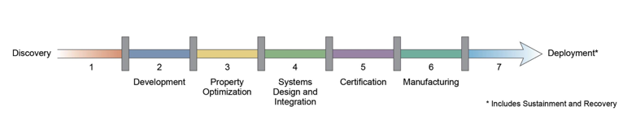
MGI: A MULTI - AGENCY PARTNERSHIP
Discovery Property Certification Deployment
optimization
Development system Manufacturing
design and integrations
NSF -MPS
ENG
DOD
NIST
DOE-BES
DOE-EERE
NIST
DOE
NSF/DOE sponsored PI workshops for MGI-supported research each year
DoD
Industry
?
NSF
You

Slide 27
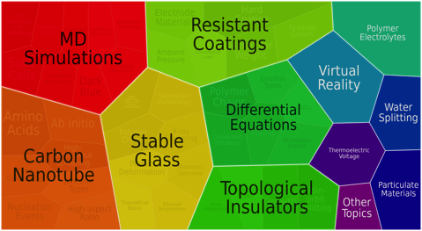
Designing Materials to Revolutionize and Engineer the Future (DMREF)
In Response to Materials Genome Initiative
Build the fundamental knowledge base needed to progress towards designing and making a material with a specific and desired function or property from first principles
Accelerate materials discovery and development.
Experiments must drive theory/simulation and theory/simulation must drive experiments: through a Collaborative and Iterative process.
MPS: DMR, CHE, DMS,
ENG: CMMI, CBET, ECCS
CISE
FY12: $13.6M
FY13: $22.2M
FY14: $30.0M
FY15: $32.0M

Slide 28
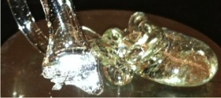

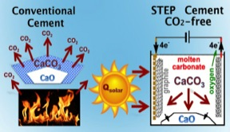

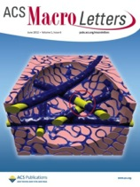


Sustainable Materials - High Priority Research
SEP: Sustainable co-synthesis of cement and fuels
SusChEM/EAGER: Extracting glassmaking raw materials from food waste, “Sustainable Mining?”
→ Silica
CaO
Alumina
Ivan A. Cornejo & Subramanian Ramalingam, Colorado School of Mines
Stuart Licht ((GWU)
Soda and K₂O
EAGER & SusChEM
AWARD - WINNING
NANOFILTERS FOR CLEAN WATER
Conventional filter: High-tortuosity
barrier layer
Ideal concept: Fully directional water pathways
New filter: Directed water channels using biomass nanofibers
No electricity, chemicals, or pressure required.
Works by gravity alone.
Flow rate = 1 cup/min.
99.9999% of bacteria trapped.
Directed filter nanochannels increase water flux by ~10 times!
Ben Hsiao and Ben Chu (StonyBrook U.)

Slide 29

Cyber Infrastructure Framework for 21st Century Science and Engineering (CIF21)
Cyberinfrastructure to transform research, innovation, and education
Major components
  Computational and Data-enabled Science
  (CDS&E)
  Core Technologies, Tools, Algorithms
  Big Data Projects
  Workforce Development
  Partnerships: internal/external
  Software Institutes
For DMR: CIF21 supports DMREF, MIPs, and MGI!

