Slide 1
2015 MRSEC Director’s Meeting
Division of Materials Research
Materials Research Science and Engineering Center (MRSEC)
October 13, 2015
Dan Finotello & Alfredo Caro

Slide 2
10/14 – 10/15 MRSEC Review
Class of 2014 Awards Made
Education Directors Meeting
4th Year Site Visits (Class of 2011)
Inherited PREM
iSuperSeed Supplements
Annual/Final Reports (35; 12 still to land)
2nd Year Site Visits finalized (Class 2014)
COV: Report available in November
2016 Solicitation (in the works)
Added PD (A. Caro)

Slide 3
MRSEC History
1960-61 - Interdisciplinary Research Labs (IDLs) -ARPA
1971 - Proposal to transfer IDLs to NSF as a result of the Mansfield Amendment
1972 - NSF establishes DMR, MRL program
1984 - DMR establishes MRG program
1994 - DMR establishes MRSEC program
2005 - DMR requests a study of the MRSEC program by the National Academies
2010 - DMR establishes CEMRI (2+ IRGs) and MIRT programs
2013 - DMR drops CEMRI/MIRT nomenclature and returns program name back to MRSEC with no small group competition and no 1 IRG MRSEC
2016 - ?
Notes:
DMR = NSF Division of Materials Research
ARPA = Advanced Research Project Agency
IDL Interdisciplinary Laboratory
MRL = Materials Research Laboratory
MRG = Materials Research Group

Slide 4
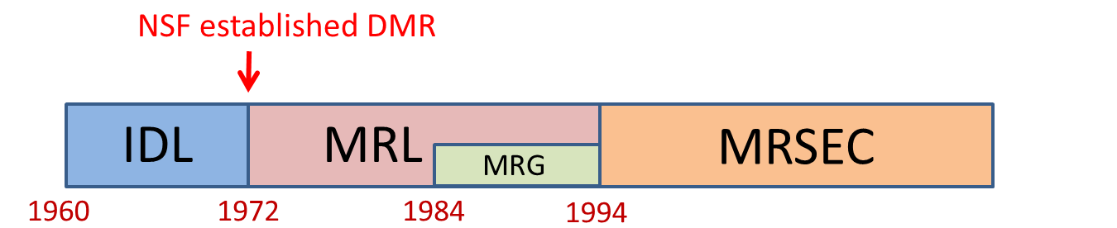
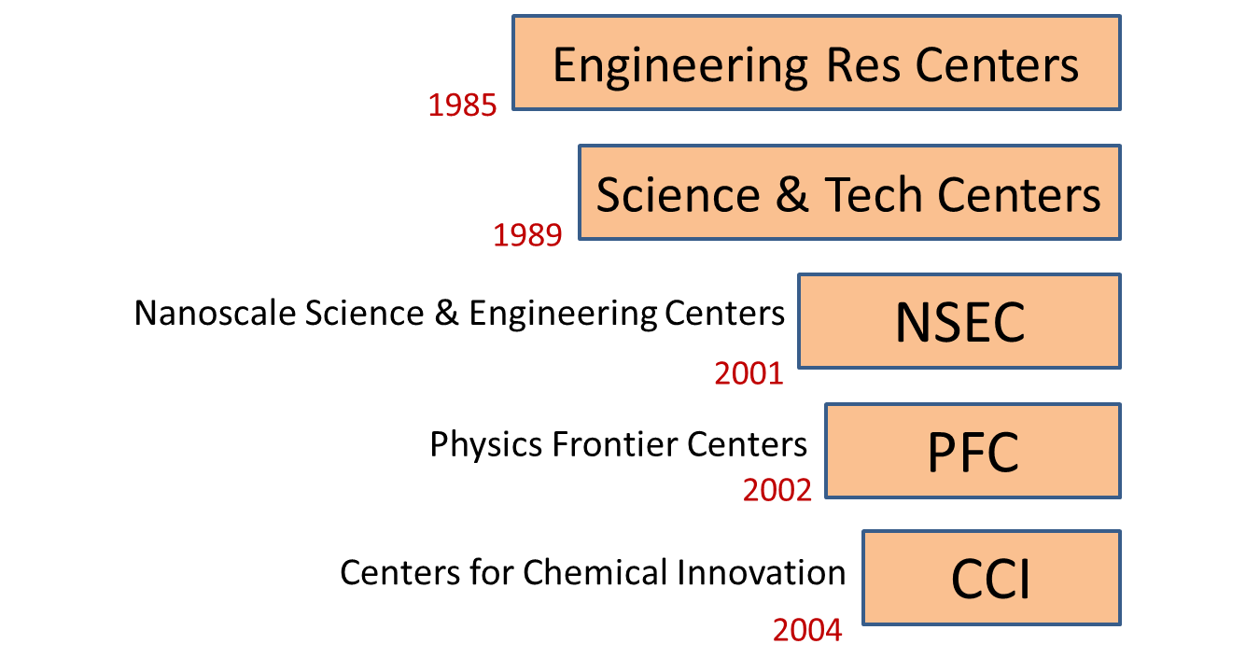
MRSEC & Other NSF Centers
2011
CEMRI
IDL/MRL University | Year Initiated
Cornell | 1960
Pennsylvania | 1960
Northwestern | 1960
Chicago | 1961
Harvard | 1961
MIT | 1961
Pennsylvania State | 1974
Ohio State | 1982

Slide 5
MRSEC Program Goals
Stimulate and support outstanding interdisciplinary research and education in materials of a scope and complexity that requires a center
Critical mass of investigators of complementary expertise
Address fundamental, complex materials problems that are intellectually challenging and important to society
Foster partnerships between academia and industry, National labs, and international
Broaden participation of groups under-represented in the sciences
Re-competition model and Seed program provide a mechanism for a reinvention and adaptation to address emerging areas (flexibility)

Slide 6
Interdisciplinary Research
Groups (IRG): Core Unit
Each IRG:
  Addresses a major materials topic or area synergistically
  Involves several researchers with complementary backgrounds, skills, knowledge.
  Is more than a ‘collection of individual investigators’
  synthesis, theory, characterization, evaluation, applications
Interaction within an IRG is critical
Interaction among IRGs not required, but may strengthen the MRSEC
Collectively, the MRSEC topics cover the entire research breadth that DMR addresses as a division

Slide 7
Additional Features
“Flexibility” to develop new areas, support for ‘SEEDs’.
  Potentially Transformative; Attract new faculty
  Important to review mechanism and effectiveness of Seed Program; re-competition
Education (precollege to postdoctoral) and development of human resources
  REU requirement (built in); RET
  Other education outreach activities scale with the size of the MRSEC.
Diversity Strategic Plan – all levels
Shared experimental facilities (Materials Research Facilities Network)
Active collaboration with industry and other sectors.

Slide 8
MRSEC Awards Do Not Sunset
Six year awards, $56M* total in 2014; Individual Center support from $1.6M to $3.53M
Annual PI meetings (October 13, 2015)
Program Director “only” Site Visit in year 2 (12 in 2016)
Site visit review with a panel of experts during year 4 (9 Site Visit in 2015)
Existing MRSEC compete with new proposals in open competition
Notes:
SVR= Site Visit Report
RSV= Reverse Site Visit

Slide 9
MRSEC Expenditures 2014 as % of Total Budget, $56 M/yr
Majority of Research funds (IRGs + Seeds) pay for Graduate student and Post-doc salaries.

Slide 10









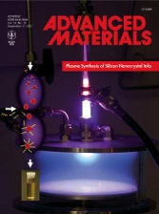





High Impact
23 MRSECs (2014)
56 IRGs
1348 publications (33% 2+ authors)(range 14% - 55%)
79 patents issued
20 MRSEC
634 TT Faculty participants (21%F; 8.4%URM); 27% PHY, 20% CHE, 18.5% MS, 11.3% each EE & CE
729 GS (24.3% F, 6% URM)+ 165 UGS (35% F, 6.7% URM)
278 Post-docs (24.8% F, 8.3% URM)

Slide 11

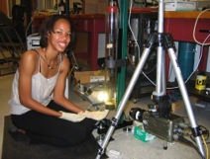


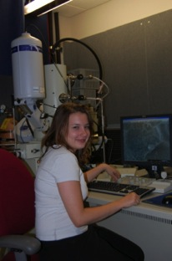


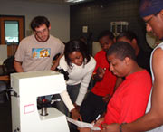

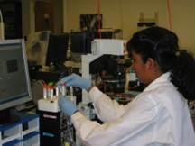
Education Outreach,
Developing a Diverse Workforce (2014)
Extensive Education Programs (20 MRSEC)
MRSEC REU (219), RET (49)
67,000’s impacted by K-12+ outreach
Broadening Participation
Diversity Strategic Plan
PREM
Extensive Collaborations
    A (419); NL (114); Ind. (159); Int. (169)
Building a National Network
    Education Coordinators Network
    Materials Research Facilities Network

Slide 12
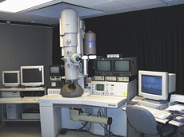
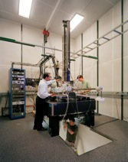
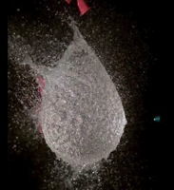
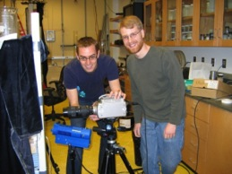

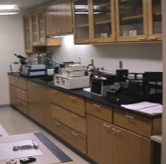

Infrastructure mrfn.org
1115 Instruments
MRFN Statistics
27 centers
1115 instruments
249 experts
Recently added instruments
Waters Breeze DMSO GPC
Hysitron Ubi-1 Nanoidenter
Yearly Users of MRSEC Facilities
  > 1300 Academic
  > 460 Industry
  >50 National Labs
Over 650 Publications annually acknowledge MRSEC SF
85 Technical Staff in SEFs (250 total)
22 Other Technicians
48 Administrative Staff
31 Education Staff

Slide 13
























Innovation
MRSEC Startup Companies
Since 1985: 134 companies in 22 states plus 3 abroad employing > 2360 individuals

Slide 14
Program Directors: 2002 - Present
Maija Kukla: Fall 2002 – March 2008
Thomas Rieker: March 2003 – 2012 (2011 Comp.)
½ Charles Ying: Aug 2006- 2013
Rama Bansil: Sept 07 – Aug 2009
William Brittain: Dec 2008 – Dec 2009
Sean Jones: February 2009 – 2013 (2011 Comp)
Ulrich Strom (ret.): 2011 Preproposal Comp
Mary Galvin: Nov 2010 – 2012 (2011 Comp)
Charles Bouldin: 2013
Dan Finotello and Linda Sapochak: July 2013 – June 2014
Dan Finotello: July 2014
Jose Alfredo Caro: October 2015

Slide 15

2014 MRSEC Competition
Pre-proposals (Panel Reviewed): August 26, 2013
  Topics were sought that solve fundamental, timely and complex materials problems that are intellectually challenging, important to society, and that potentially broaden the current portfolio. MRSECs included 2-5 IRGs.
  Preliminary proposals reviewed based on the topical areas of IRGs, thus the IRGs in a MRSEC proposal may be reviewed by different panels if the research areas are dissimilar.
  81 pre-proposals (246 IRGs) reviewed in seven topical panels convened at NSF from October 28 to November 15, 2013.
  26 MRSEC including 65 IRGs Invited: 50-50 new-recompete
Full proposals (Mail Reviewed) due January 10, 2014: Invitations “sent” on November 22, 2013
Reverse Site Visit Panels: 15 MRSEC with 39 IRGs Invited on April 10; RSV Panels from May 20 to June 12.
Awards: November 1, 2014: 12 MRSEC with 32 IRGs.

Slide 16
2014 MRSEC Competition

Slide 17
Summary:2011 & 2014 MRSEC Competitions
(9) 12 Awards - National investment in the areas of sustainable energy, bio- and soft-materials, polymers, nanoscience, next-generation electronics and photonics, and condensed matter physics.
    (3) 1 award to institutions that have not had a MRSEC
    (9 of 13) 11 of 14 MRSECs successfully re-competed
    21 MRSEC including 56 IRGs (started with 23 and 58)

Slide 18
MRSEC Class of 2014
12 Awards: National investment in the areas of sustainable energy, bio- and soft-materials, polymers, nanoscience, next-generation electronics and photonics, condensed matter physics: Brandeis, Chicago, Colorado, Columbia, Harvard, Minnesota, MIT, Nebraska, NYU, Ohio State, Penn State, Princeton.
1 New Award: Columbia MRSEC; 11 MRSEC: Successfully re-competed
Class of 2011: Cornell, Duke, Michigan, Northwestern, Penn, UC Santa Barbara, Utah, Wisconsin, Yale.
Currently: 21 MRSEC including 56 IRGs; 2 with 4 IRGs; 10 with 3 IRGs; 9 with 2 IRGs.

Slide 19
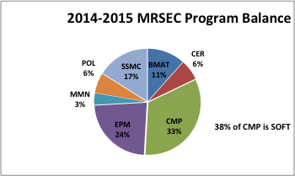
2015 MRSEC Program Balance
Mapping to DMR IIP
21 Centers with a total of 56 IRGs
 | IRG OVERLAP
BMAT | 23%
CER | 71%
CMP | 24%
EPM | 8%
MMN | 50%
POL | 71%
SSMC | 33%

Slide 20
2015 MRSEC iSuperSEED Supplements*
The Materials Research Science and Engineering Center program of the Division of Materials Research is making available, depending on funds availability, 3-4 iSuperSEEDs. The iSuperSEED topics of interest must be part of the DMR research portfolio of interest, and for this call they are:
Topological Insulators. Theory leading experiment efforts focusing on but not limited to dichalcogenides, Majorana fermions, Weyl semi metals are welcome topics.
Quantum Information Science. Topics may include (but not limited to) developing materials, techniques and classical simulation methods for controlled evolution of quantum mechanical states of multiple to many qubit systems utilizing existing qubit technologies, such as quantum dots, superconducting qubits (e.g.transmons and fluxonium), nitrogen vacancy centers, optically-active defects (color centers), quantum cavities, nanomechanical qubits and hybrid qubits
BRAIN-related studies (see Alivisatos et al., Nanotools for Neuroscience and Brain, VOL. 7, # 3, 1850–1866 (2013), www.acsnano.org, for definitions and appropriate research topics)
Sustainable Materials (see DMR DCL NSF14-077)
4 funded at $250,000 each
*Hopefully every 2 years

Slide 21
2015 MRSEC Supplement Support
He⁴ Recovery Systems (DMR allocates $1M per year): $364,780 (Report to Congress on items required by Sec, 19 of the Helium Stewardship Act of 2013 Public Law 113-40)
Webmaster for mrsec.org, mrfn.org and prem.org: $126,000
GRSV Fellow: $34,625 (the only one in MPS)
Total 2015 MRSEC Investment: $57,525,405

Slide 22
PREM 2015 and 2012 Classes; Chuck; Sean/Tess; Dan
Institution | Partner | Research Focus
Cal State Univ Los Angeles+ | Penn State | Manganites, perovskites, catalytic nanopumps
Hampton University+ | Brandeis | Polymeric thin films, protein interactions, bioinspired drug delivery systems
North Carolina Central University+ | Penn State | Semiconductor nanostructures, plasmonic materials, 2D mat for spintronics
New Mexico Highlands University+ | Ohio State | Crystal engineering, MOFs, nano-modified graphene metamaterials
University of Puerto Rico at Humacao | University of Pennsylvania | Multi-functional nanodevices from optoelectronic materials and Nanoscale interactions of macromolecules at soft and hard interfaces
The University of Texas Rio Grande Valley | University of Minnesota | Perovskite metal oxides, ionic liquid-based electrolytes, conjugated polymers for photovoltaics, spinel nanoparticles
California State Univ – Northridge | Princeton University MRSEC | Computational materials Science
Howard University | Cornell Univ MRSEC, Prince George Comm College, Gallaudet University | Growth and transport studies – Topological Insulators and III-V mtls
Jackson State University | Univ of California-Santa Barbara MRSEC | Organic electronics sensors
Norfolk State University | University of Michigan MRSEC | Metamaterials and surface plasmons
⁺Texas State Univ - San Marcos | Duke University (Triangle) MRSEC | Multiscale colloid interfaces/self assembly
⁺University of Texas El Paso | Univ of California-Santa Barbara MRSEC | Organic photovoltaics
Class of 2015
Class of 2012
⁺New starts

Slide 24

The NSF Graduate Research Fellowship Program
nsf.gov/grfp
www.nsfgrfp.org
Notes:
To ensure the vitality of the STEM human resource base, GRFP invests in diverse, outstanding graduate students, who are pursuing research-based master's and doctoral degrees in NSF-supported disciplines.
Responsive to national needs for a strong, diverse and globally engaged science and engineering workforce

Slide 25

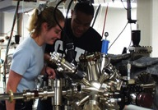
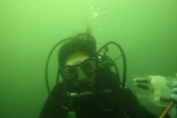

GRFP Overview
Initiated 1952
46,500 Fellows to date
30 Nobel Laureates & 440 National Academy of Sciences members
4,600 Active Fellows in 200 institutions
Higher Ph.D. completion rates
Enhanced diversity
Notes:
Leverages NSF resources to broaden the participation of underrepresented groups
Facilitation Awards for Scientists and Engineers with Disabilities

Slide 26
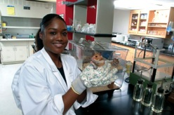
GRFP Goals
To increase the Nation’s human capacity in science and engineering by providing fellowships for early-career graduate students who pursue research-based master’s and doctoral degrees in NSF-supported disciplines
To support the development of a diverse and globally engaged US science and engineering workforce
Notes:
Broadening opportunities and enabling the participation of all citizens, women and men, underrepresented minorities, and persons with disabilities, are essential to the health and vitality of science and engineering. NSF’s commitment to broadening participation is embedded in its Strategic Plan and deems it central to the programs, projects, and activities it considers and supports. The goals of the GRFP strongly support broadening participation.
GRFP:
Identifies Nation’s future science and engineering leaders
Focuses on the individual
Promotes diversity in the science and engineering workforce
Adheres to the Merit Review Criteria
The GRFP supports individuals proposing a comprehensive holistic plan for graduate education that takes into account individual interests and competencies. Applicants must provide a detailed profile of their relevant educational and research experiences and plans for graduate education in such a way as to demonstrate potential for significant achievements in science and engineering.

Slide 27
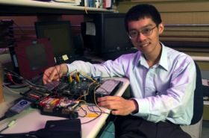
GRFP Eligibility: self-certified
U.S. citizens and permanent residents
Early-career graduate students
Pursuing research-based MS and PhD
NSF supported fields
Enrolled in accredited institution in US
Academic Levels
1: Seniors/baccalaureates; no graduate study
2: First-year graduate students
3: Second-year grad students
  ≤ 12 months of graduate study by August
4: >12 months graduate study
  Interruption in graduate study of 2+ years
      Academic levels evaluated together

Slide 28
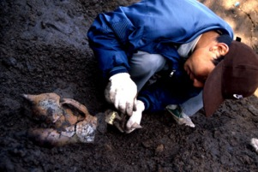
GRFP Key Elements
Five Year Award – $126,000
Three years of support
  $30,000 Stipend per year
  $12,000 per year Educational allowance to institution
International research opportunities – expanded
Supercomputer access

Slide 29
Post Award Management
Site Visits
Program Director Site Visits, Class of 2014: March – May 2016
  Year 2 of an award; 1-day
  Site visit report; short report
  New: 1 expert per IRG accompany PDs to the Class of 2014 MRSECs
Site visits with Full Panel, Class of 2014: Fall 2018; Class of 2011: Feb. – June 2015
  Year 4 of an award; 2-days
  5-8 panelists + 1-2 NSF Program Directors
  Report Written/Completed on site; Response to Site Visit Report
  SVR shared with Reviewers at Competition RSV

Slide 30
Post Award Management
Annual Reports
Annual Desk Review of all MRSECs: January – June (this year 35 AR)
  MRSEC specific Annual / Final Report Guidelines; OMB approved
  Work in Progress
  Annual Diary Note with Funding Recommendation
PI Meetings
MRSEC Directors’ Meeting: once per year. Next: October 18, 2016
  Working groups: Broadening Participation, Communication, Education, Facilities, and Industry
Annual Education Coordinators’ Meeting
  Focus on evaluation, broadening participation, and seeking sources of support outside the MRSEC program

Slide 31
2016 MRSEC Competition
Solicitation: by April 1, 2016
Pre-Proposals Due Date: July 1, 2016
  Panels: September, 2016
  Full Proposal Invitations: Mid-October 2016
Full Proposals Due Date: December 2, 2016
Reverse Site Visits:
  Invitations: Circa Mid March 2017
  Panels: Mid April to Mid May 2017

Slide 32
2011 Materials Research Centers (re-competing) and Teams Awards
9 Centers and 3 MIRTs with a total of 27 IRGs

